Slide 1
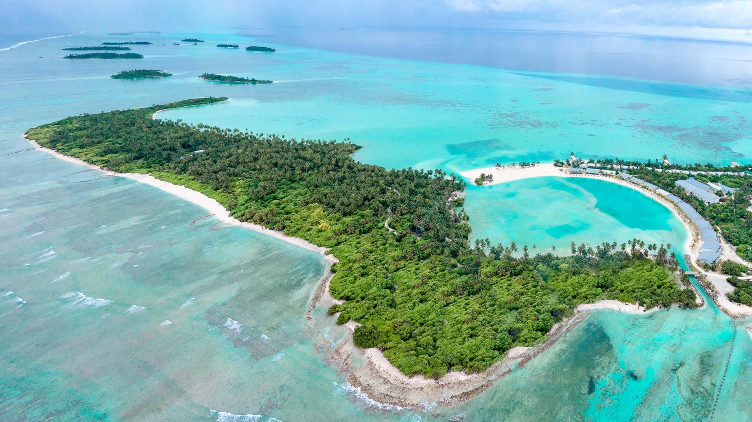
DISCOVER LAAMU WITH
RAHAA

Slide 2
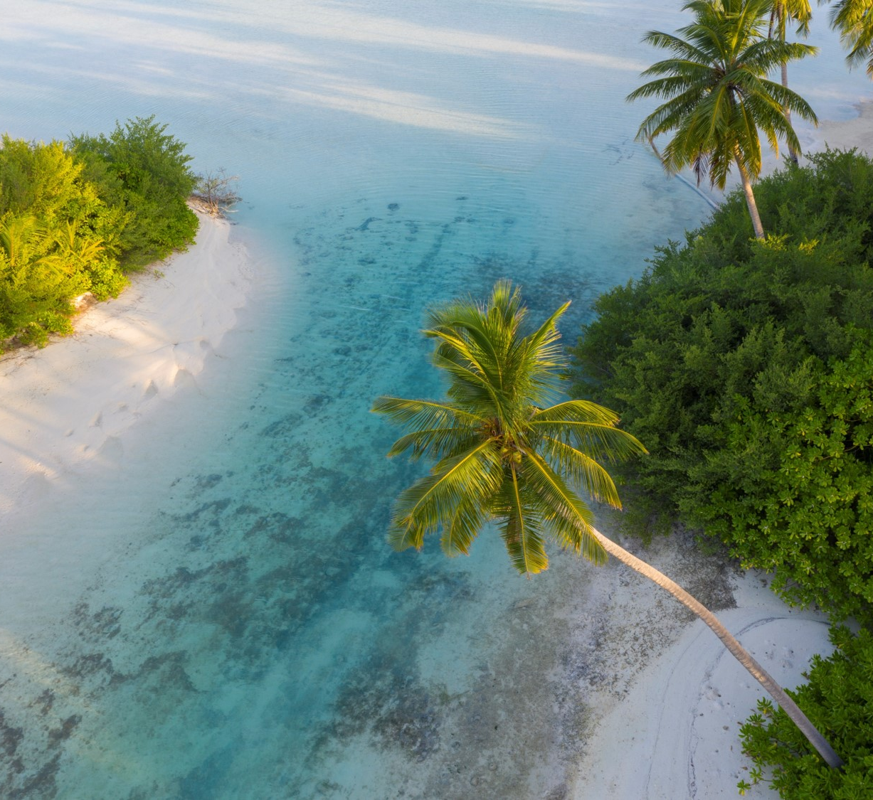
RAHAA
RESORT FACTS
4-star Resort
Located In Untouched Laamu Atoll
Privately owned and operated
Saltwater Lake – Unique Feature
Island With Natural Beauty, Long Stretches Of Beaches, Lush Vegetation
Incredible Diving And Snorkelling
One of only two Resorts in Laamu Atoll
3 Great Surfing Spots Within Close Distance
100 Beach Villas
1 Restaurant and 2 Bars.
Ideal for relaxing, snorkelling, diving and surfing holidays

Slide 3
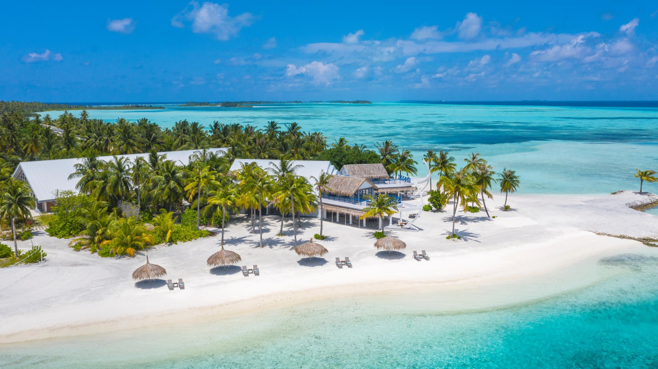

Slide 4
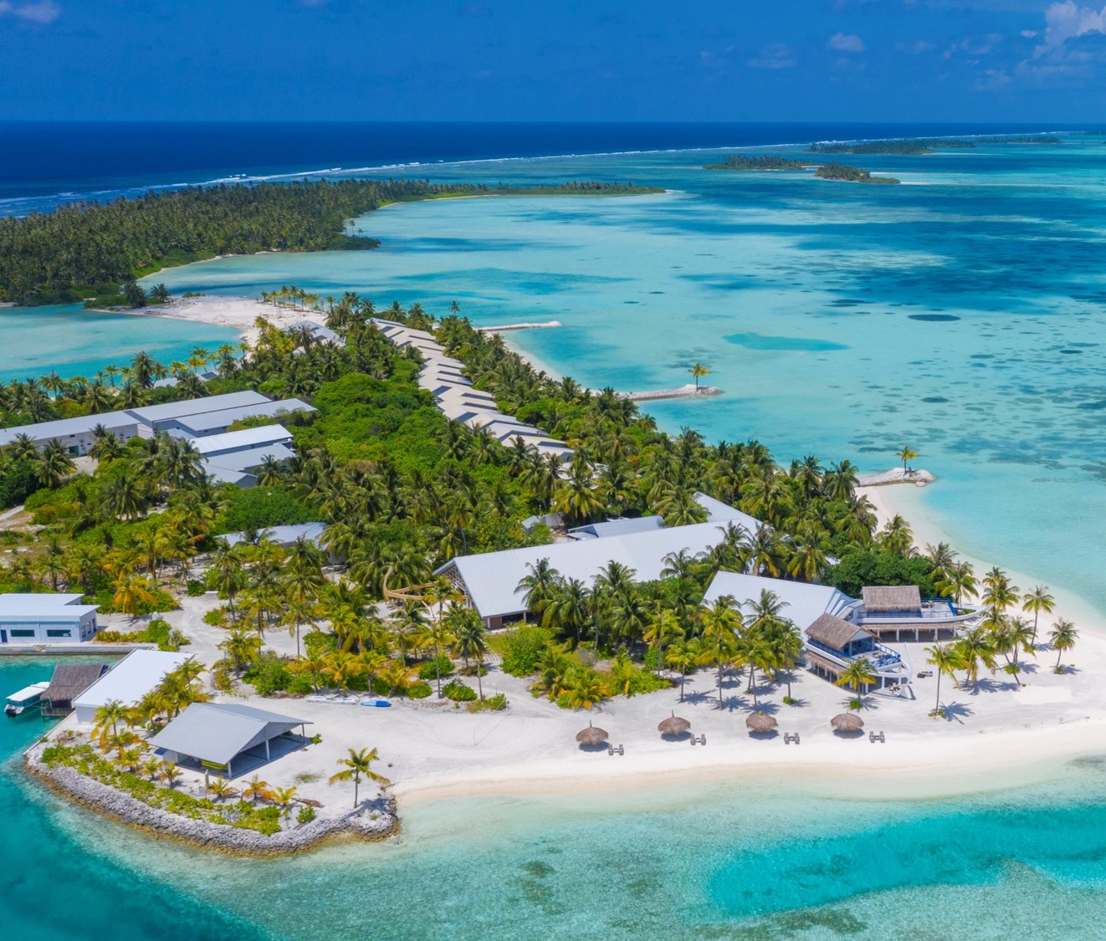
LOCATION
Laamu atoll,
South of Maldives
TRANSFER
Domestic flight ( 35 mins) &
Speedboat ride ( 20 – 30 mins)

Slide 5
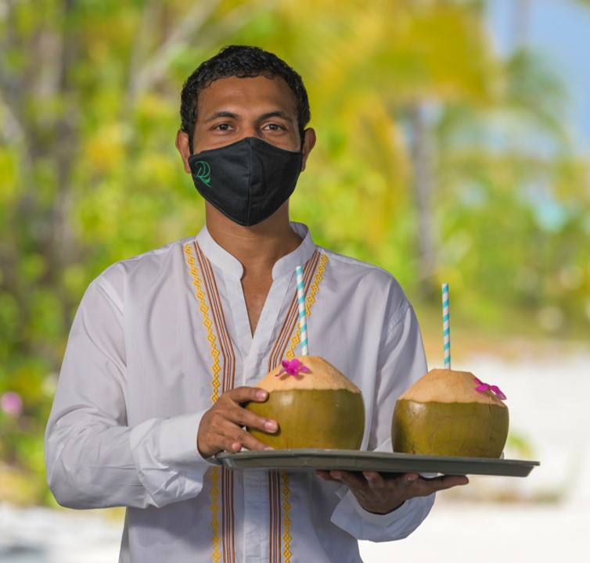
We welcome all our guests with refreshing king coconuts
freshly picked from
our palms!
STAY WITH CONFIDENCE AT RAHAA
All covid-19 related health and safety guidelines are in place to ensure our guests can relax and enjoy a worry-free stay at Rahaa
Notes:
From the moment guests step foot on the island till the end our guests will experience true Maldivian hospitality

Slide 6
HARU’GE
RECEPTION
The Design of our Reception symbolises an “Odi Haruge” - a Maldivian traditional Boat building house
“An Odi Haruge houses the Dhoni while its being built and protects it from rain and sun”
View of the Haru’ge from outside

Slide 7
HARU’GE
RECEPTION
View of the Haru’ge from inside

Slide 8
HARU’GE
RECEPTION
In addition to the reception, Haru’ge also features under it roof:
Business centre
Ice Cream shop
Island Boutique
Guest shops
View of the Haru’ge from inside

Slide 9
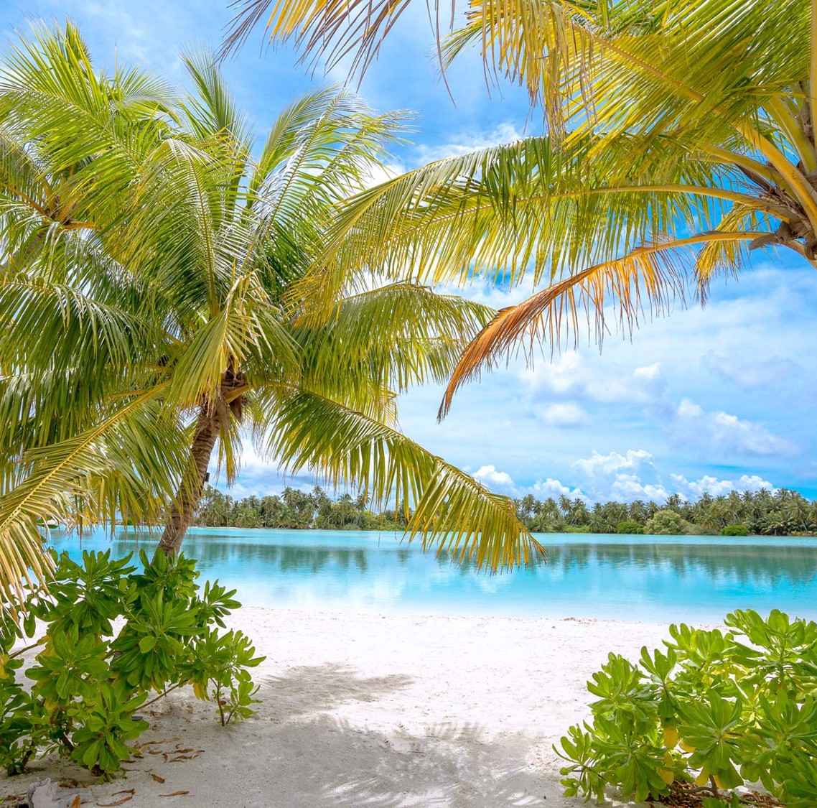
STAY AT RAHAA
For a truly authentic Maldives experience!
The unspoiled environment of Rahaa creates a sense of freedom, of being back to nature, a sense of liberation and of being at one with the surroundings.
OUR VILLAS
56 LAKE VIEW VILLAS
44 OCEAN VIEW VILLAS
“
”
View of the beautiful Saltwater Lake

Slide 10
LAKE VIEW VILLA
BEDROOM
Faces the saltwater lake
Offers exceptional views of the lake straight from the bed
Size: 74 sqm
56 units

Slide 11
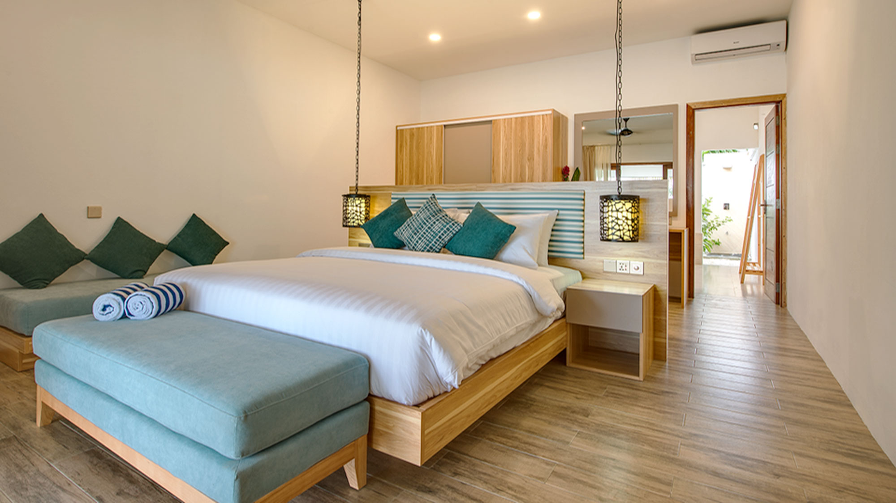
LAKE VIEW VILLA
Our villas offer all modern comforts including:
King size bed
Smart TV
Telephone
Personal Safe
Tea and Coffee making facility
Hair dryer
AC and fan
Bathrobes and bathroom amenities
Out door shower
Private terrace with daybed
Out door chairs and coffee table
Sun loungers

Slide 12
LAKE VIEW VILLA
BEDROOM
Wake up to the sounds of birds singing and the leaves rustling from a distance across the lake…

Slide 13
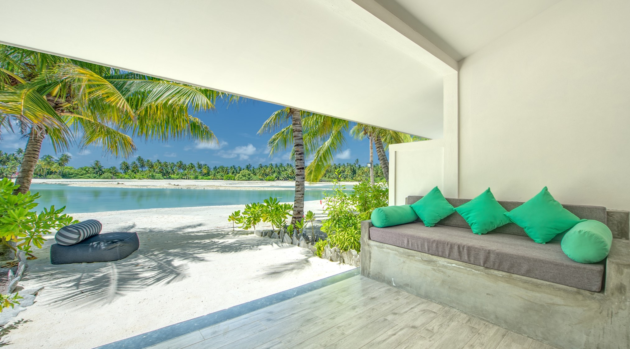
LAKE VIEW VILLA
TERRACE
…or enjoy incredible views and sunsets from your private terrace!

Slide 14
LAKE VIEW VILLA
BATHROOM

Slide 15
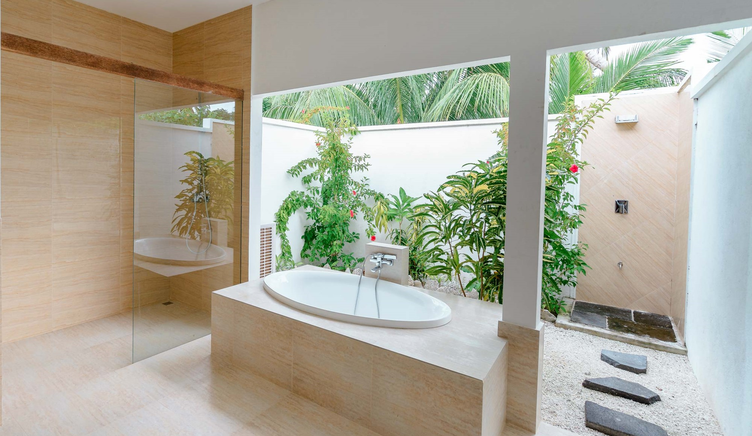
LAKE VIEW VILLA
BATHROOM
Spacious, open-air bathrooms, with his and her wash basins, bathtub and outdoor shower and garden

Slide 16
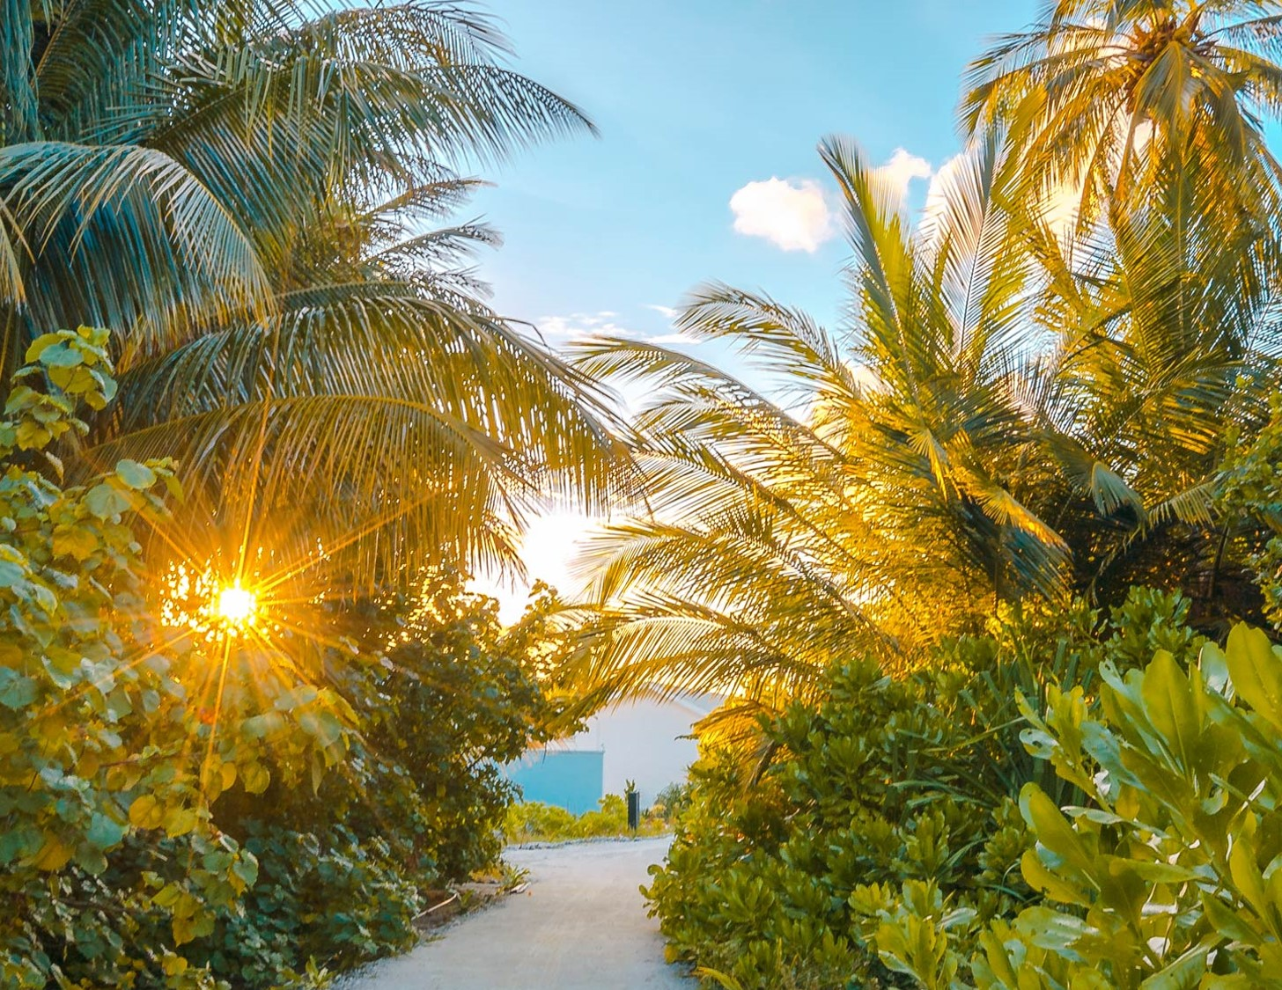
“
Interwoven with the nature, our villas fuse local materials with contemporary interiors designed for maximum sensual discovery, ultimate comfort, privacy and total immersion in nature.
”
Catch golden rays of the afternoon sun as you stroll through island !

Slide 17
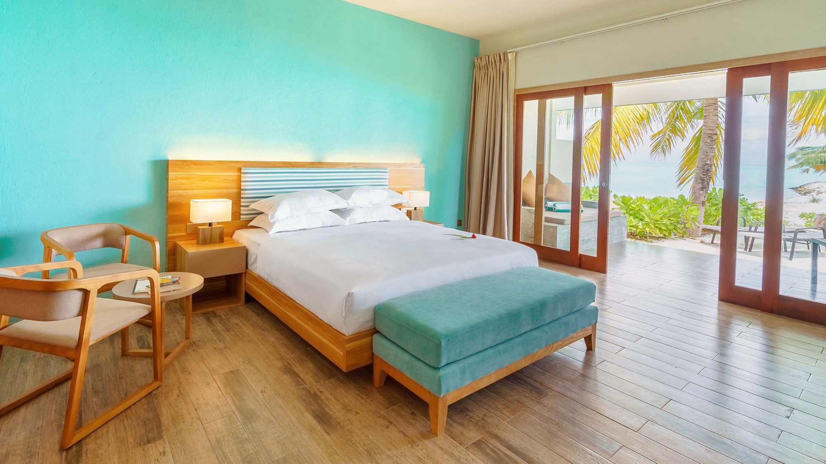
OCEAN VIEW VILLA
BEDROOM
Faces the ocean
Offer incredible views of the ocean
Size: 77 sqm
44 units

Slide 18
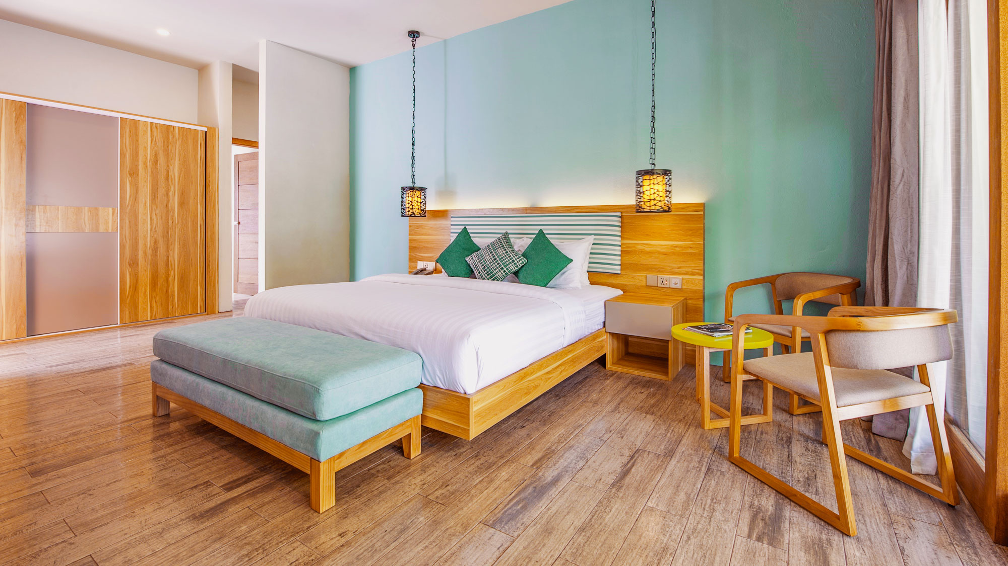
OCEAN VIEW VILLA
BEDROOM
Our villas offer all modern comforts including:
King size bed
Smart TV
Telephone
Personal Safe
Tea and Coffee making facility
Hair dryer
AC and fan
Bathrobes and bathroom amenities
Out door shower
Private terrace with daybed
Out door chairs and coffee table
Sun loungers

Slide 19
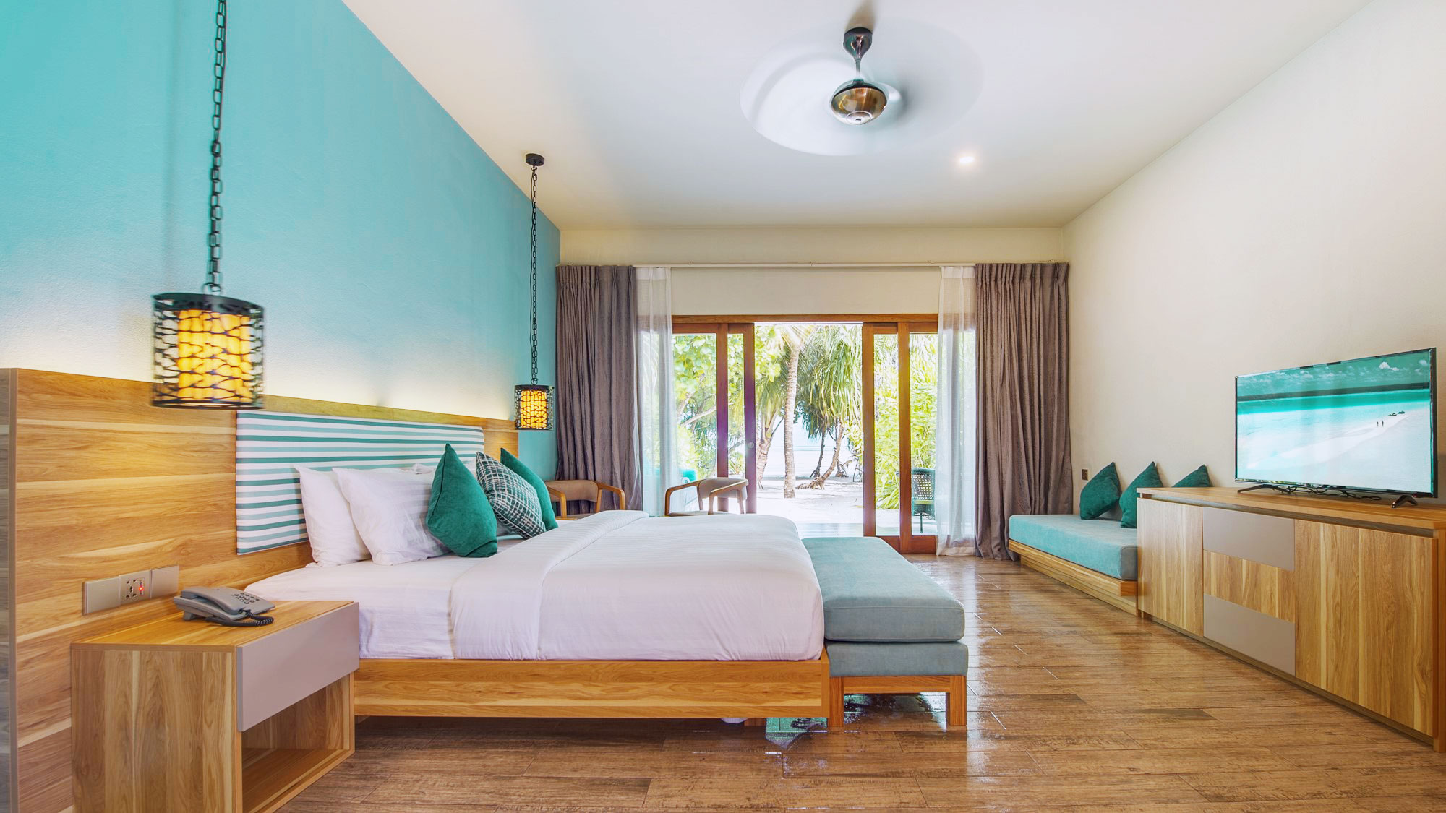
OCEAN VIEW VILLA
BEDROOM
Tucked in lush foliage and flanked by the gently swaying palms, the Ocean View Villas offers ultimate privacy and breath-taking views of the Indian ocean.

Slide 20
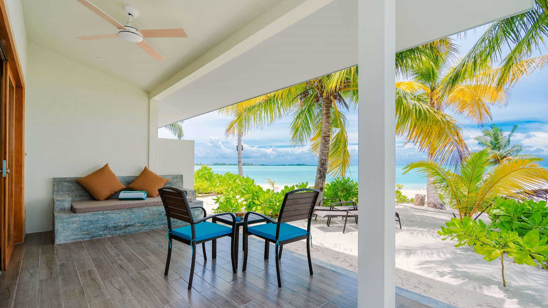
OCEAN VIEW VILLA
TERRACE
Relax on the outdoor daybed or read a book under the shade and cool ocean breeze.

Slide 21
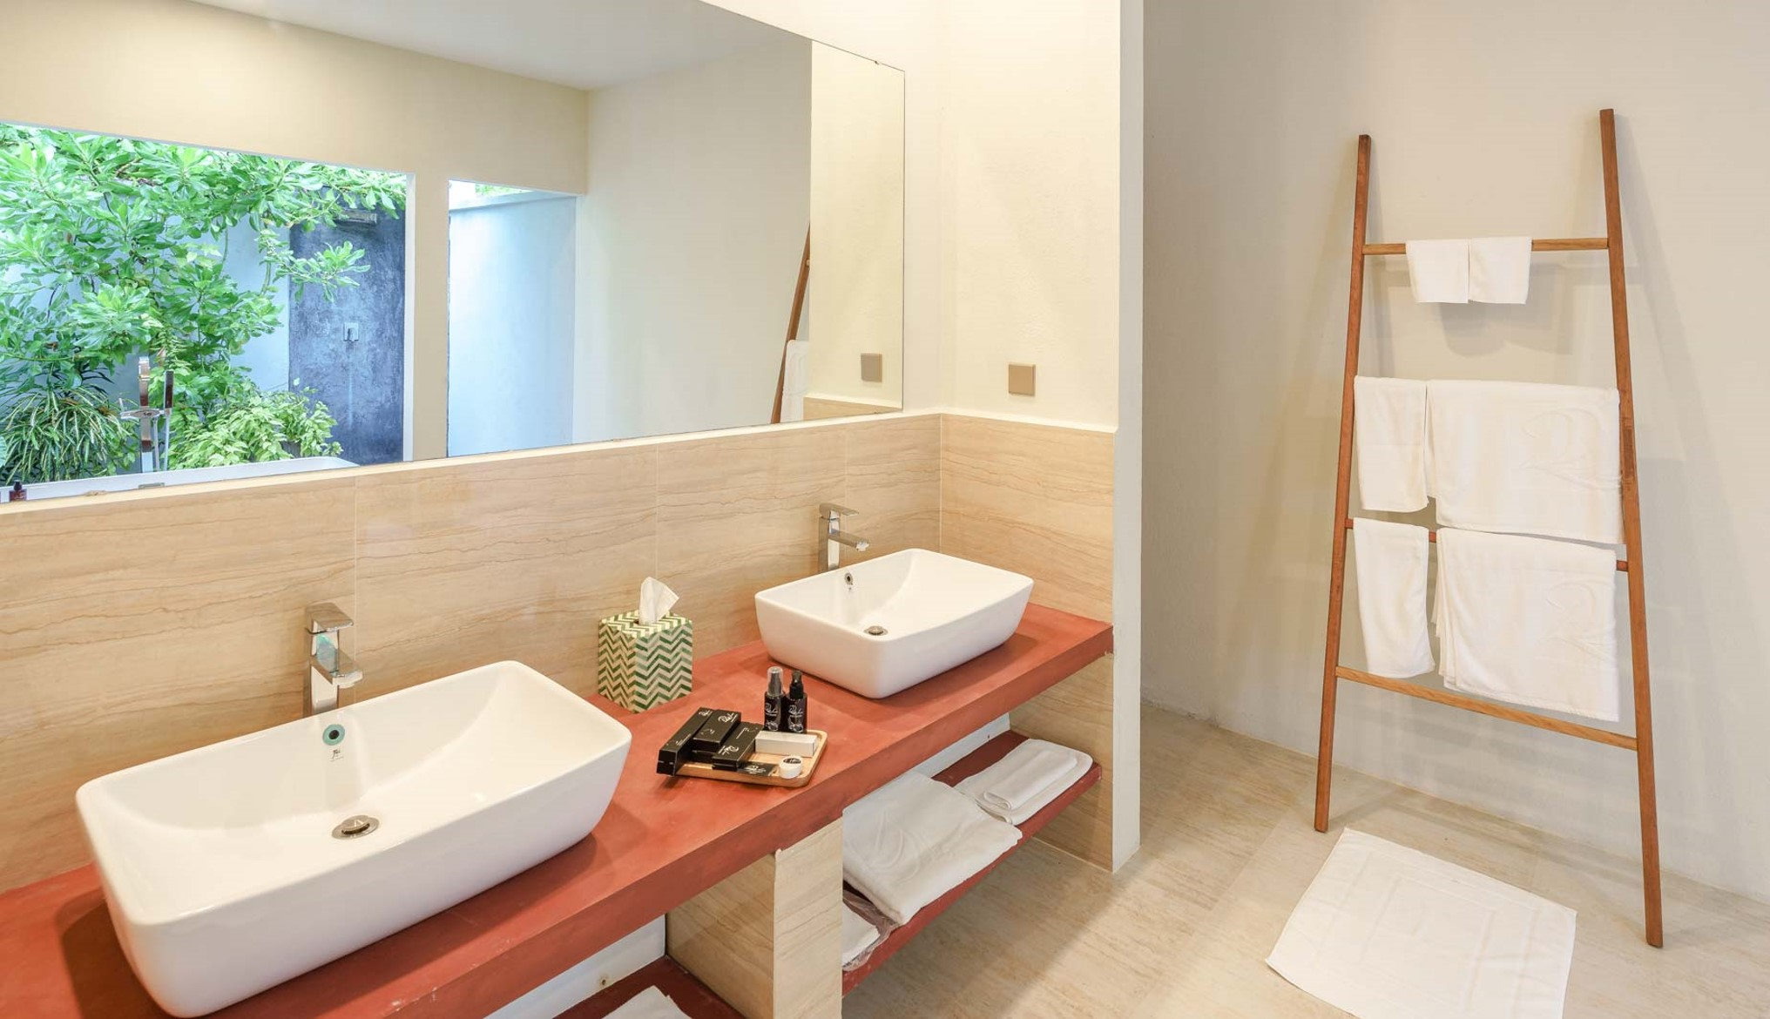
OCEAN VIEW VILLA
BATHROOM

Slide 22
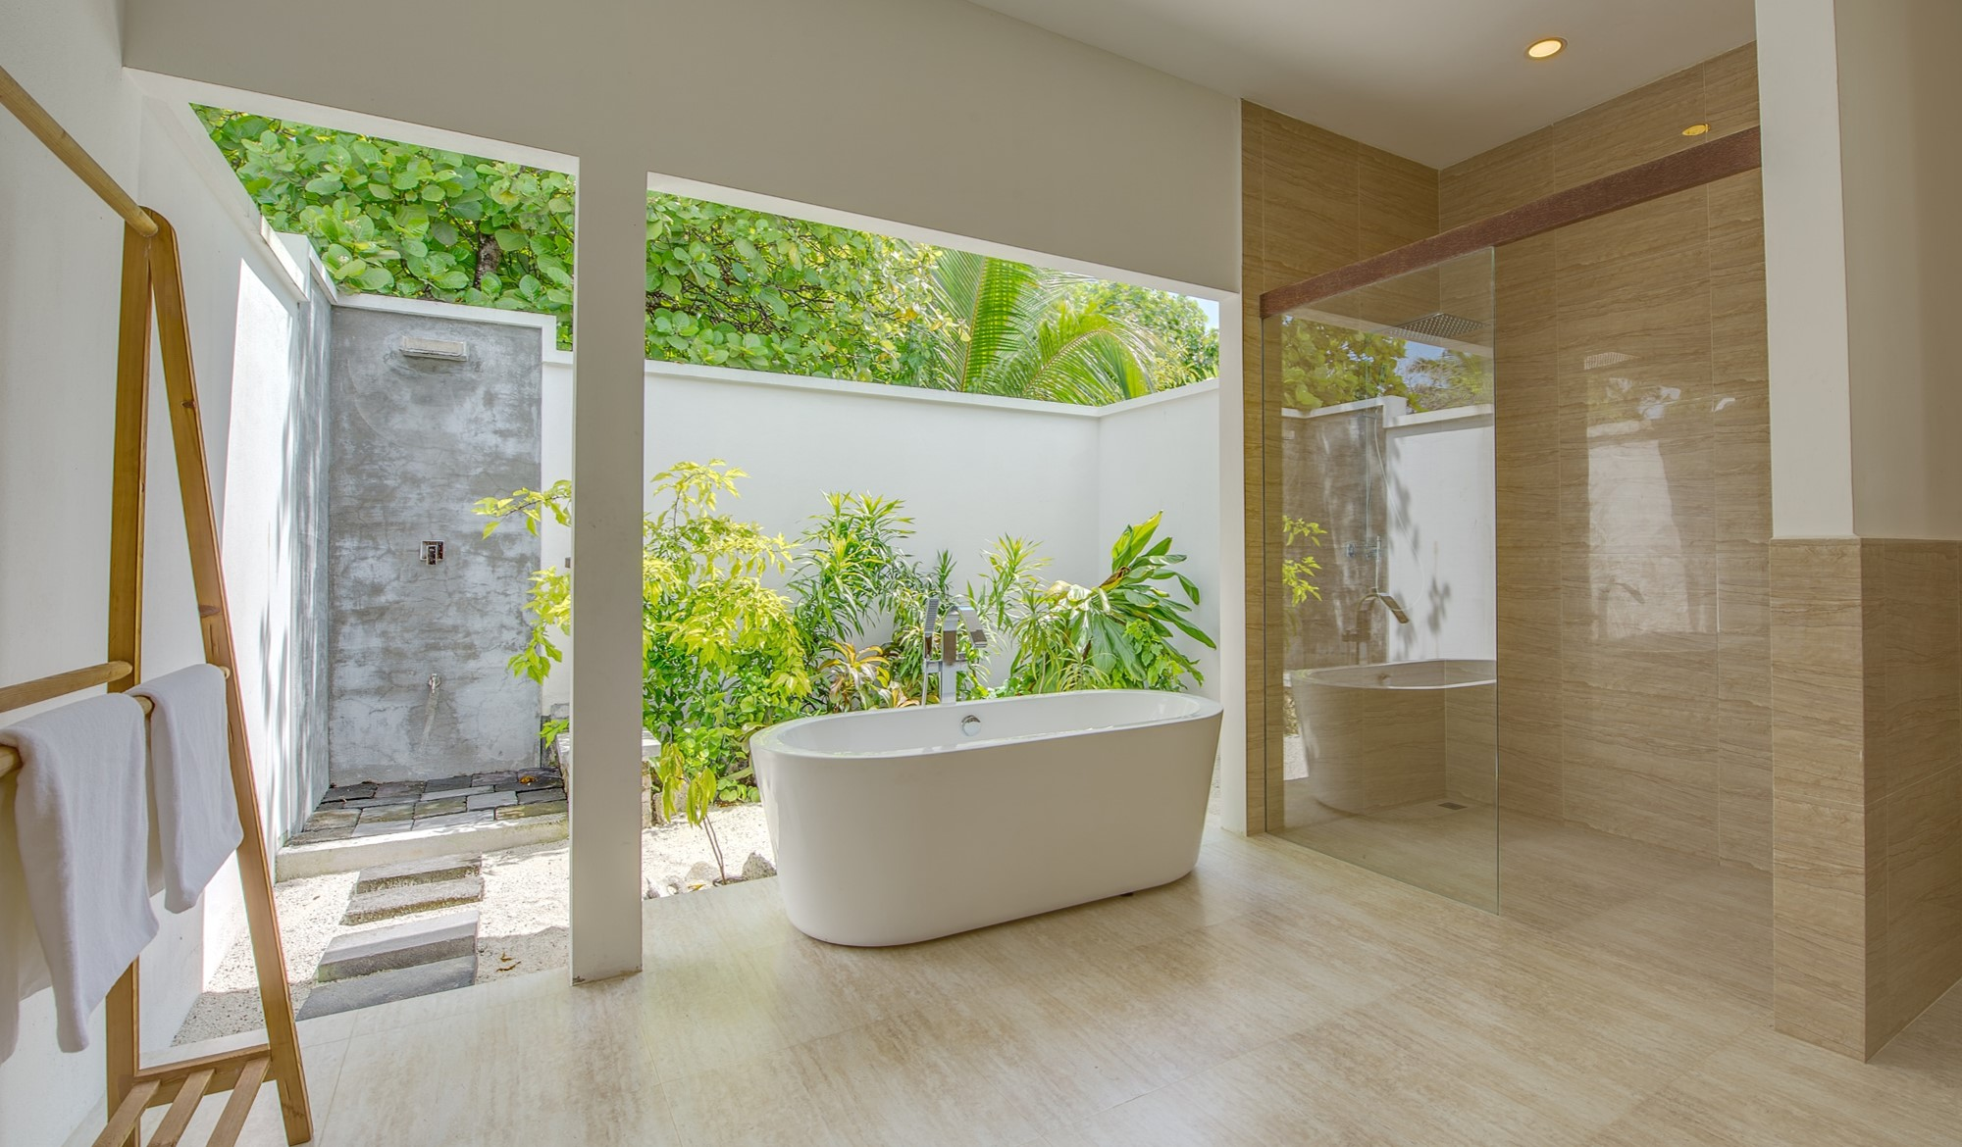
OCEAN VIEW VILLA
BATHROOM
Spacious, open-air bathrooms, with his and her wash basins, bathtub and outdoor shower and garden

Slide 23
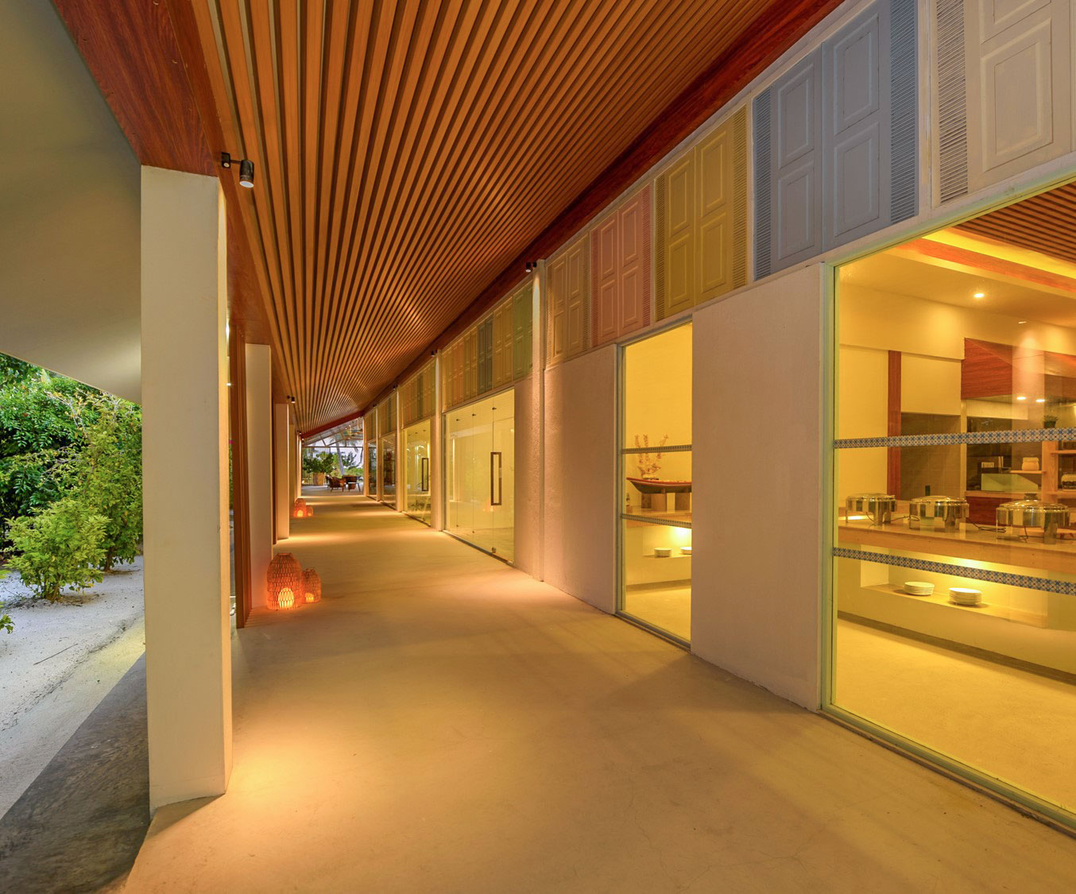
DINE AND WINE
“
Rahaa brings together the very best of local and international cuisines prepared by our multi-national chefs.
”
OUR RESTAURANTS
& BARS
KAAGÉ
Main Restaurant
DHIRUN’BAR
Main Bar
KO’BAR
Sunset Beach Bar
Walkway from restaurant and bar to reception
Ice Cream Shop
Island Boutique
Guest shops

Slide 24
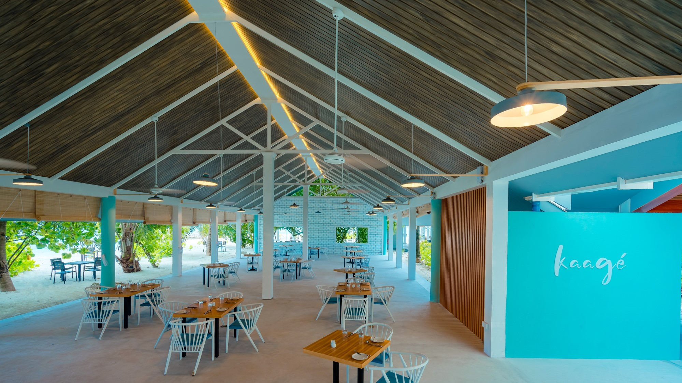
KAAGÉ
MAIN RESTAURANT
Beach-front all-day dining restaurant
Indoor and outdoor seating
Serves international cuisine for breakfast, lunch and dinner buffet style
Themed nights
Notes:
Themed nights include Maldivian night, Mediterranean night and Asian Street food night

Slide 25
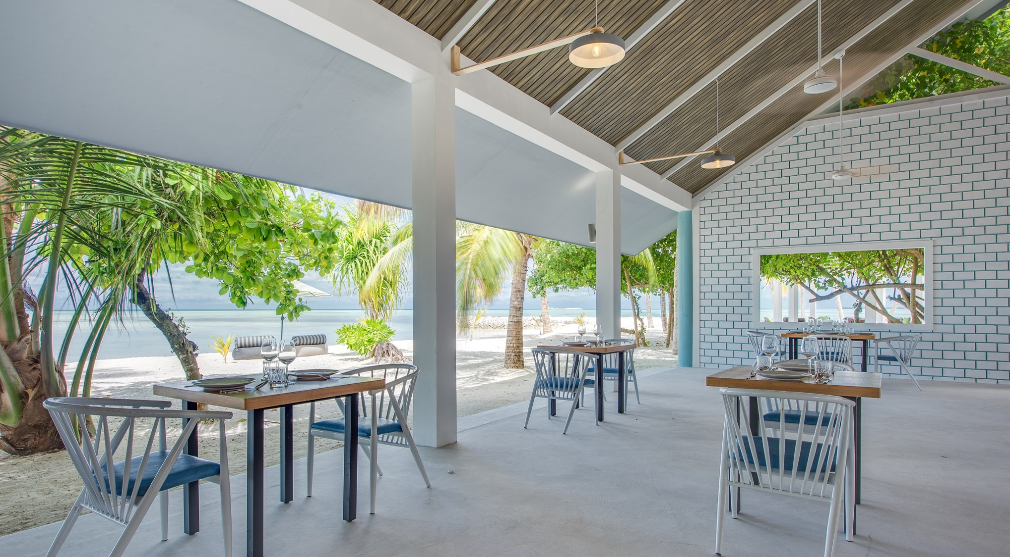
KAAGÉ
Embrace the tropical views while enjoying your meals, inside or out with your feet in the sand

Slide 26
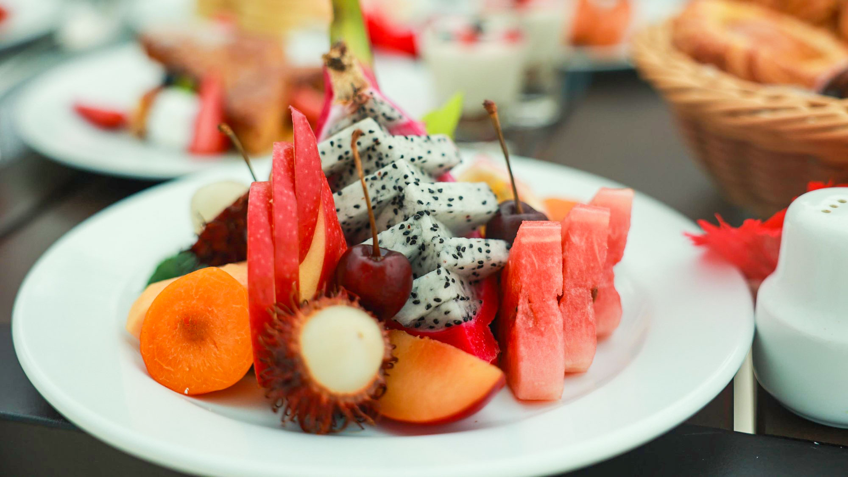
KAAGÉ

Slide 27
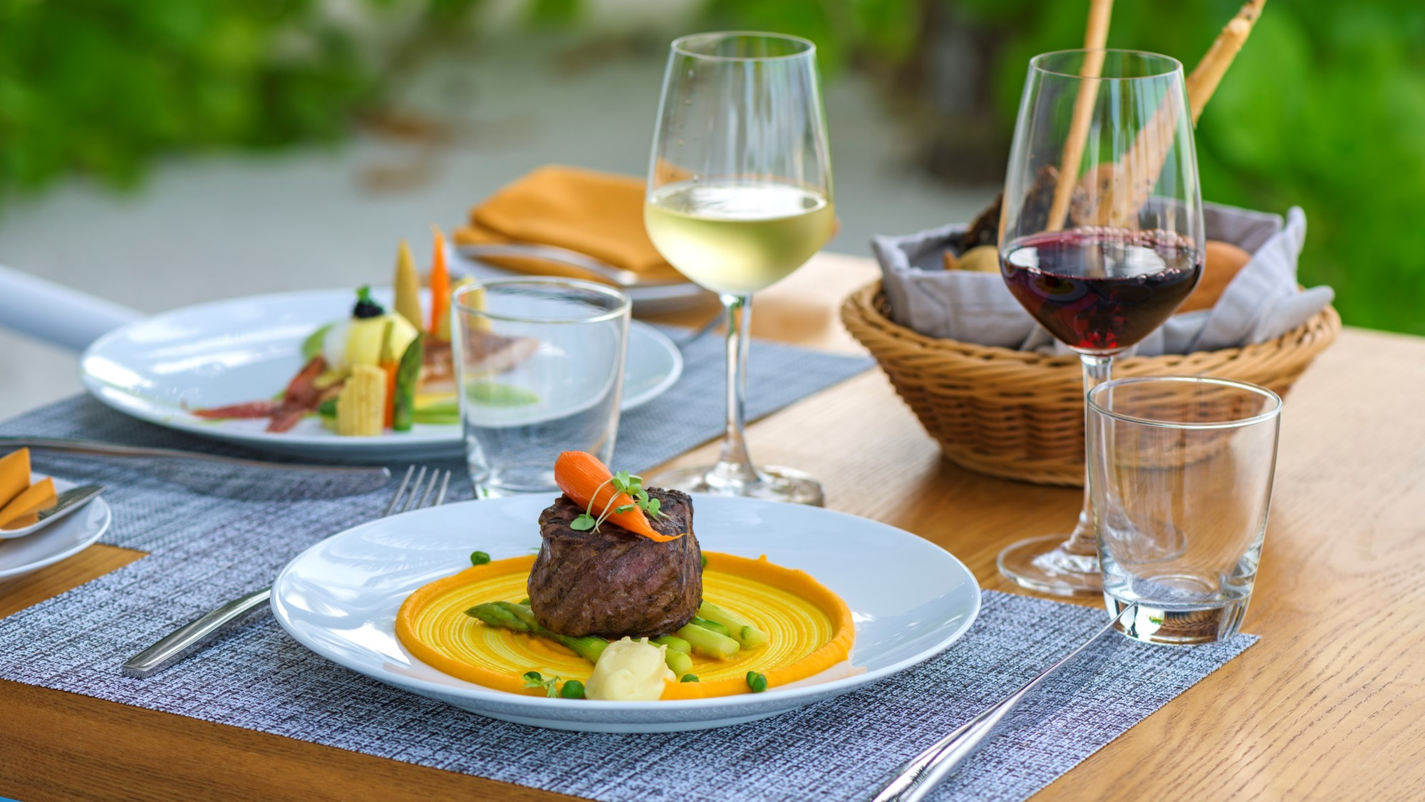
KAAGÉ

Slide 28
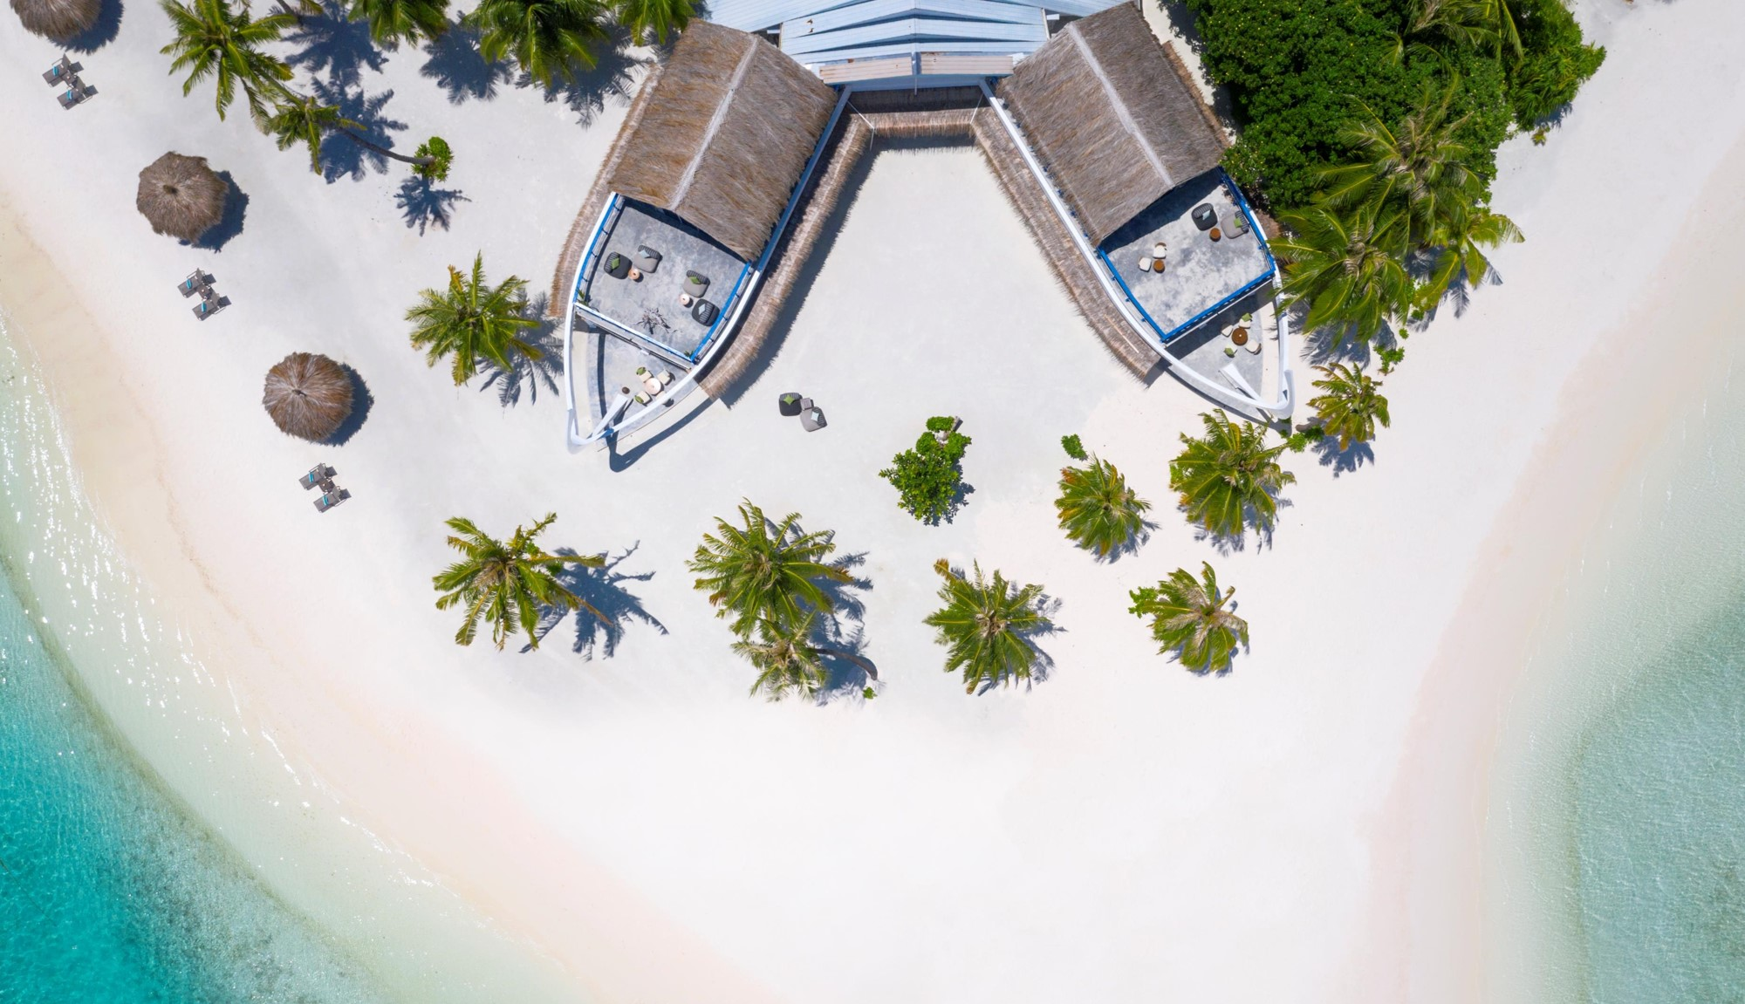
DHIRUN’BAR
BIRDS-EYE VIEW

Slide 29
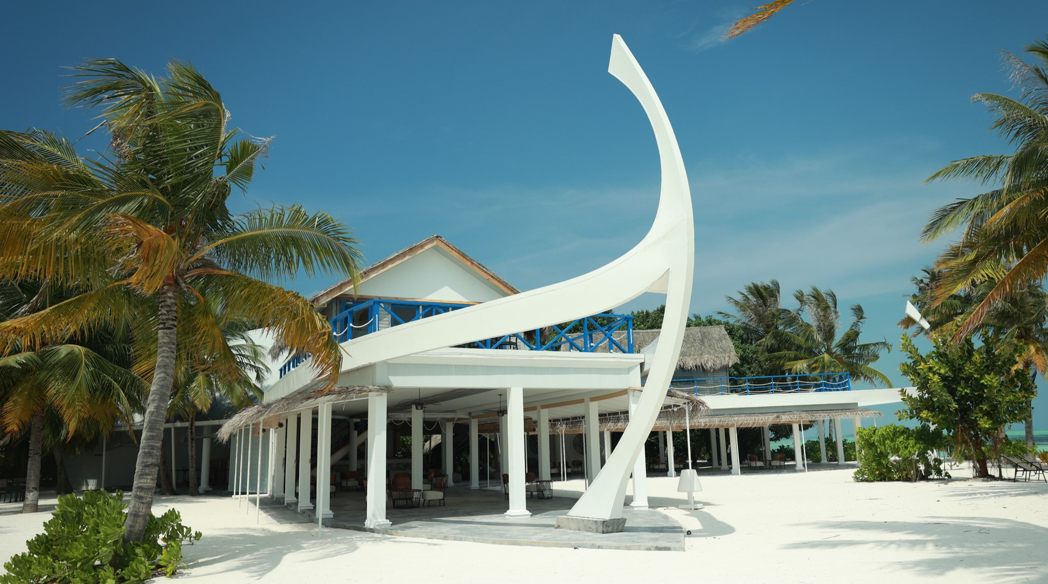
DHIRUN’BAR
MAIN BAR
The architecture and design of our main bar is inspired by the 1970’s modernized motorised Yacht Dhoni which featured two tiers.
The name “Dhirun’Bar” is derived from the local word “dhirunbaa” for the front deck of the Dhoni.
This is an important part of the Dhoni used
for lounging, watching the scenery,
catching the breeze or simply
star gazing at night.
Its also where the boat crew
would stand and look ahead
to help the boat captain
navigate in and out of the
islands or around reefs.
The “Dhirunbaa” of the Dhoni is also
where all the entertainment
happens… playing “Bodu beru” – the local drums, dancing and singing to pass time during the journey.
Due to its significance and the fact that it ends “baa” makes it the perfect name for our main
bar “DHIRUN’BAR”

Slide 30
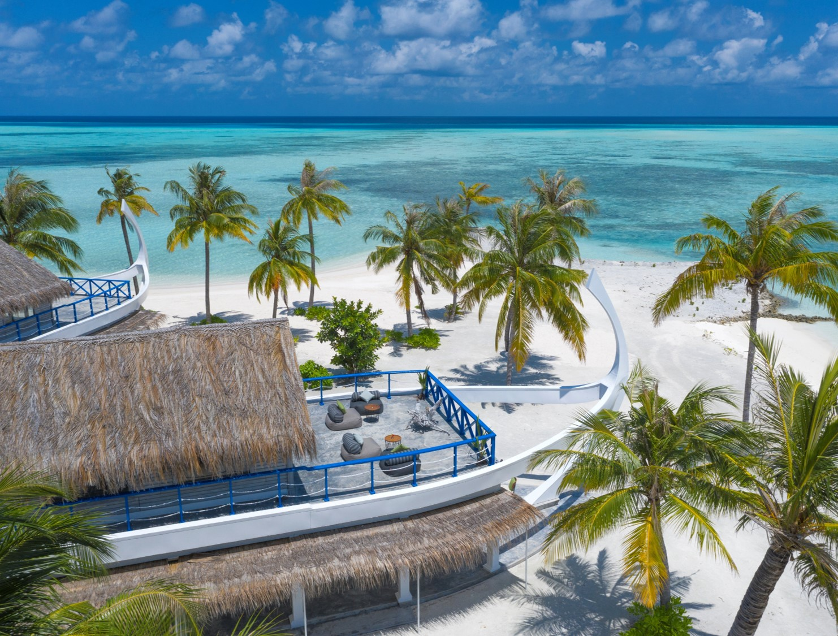
DHIRUN’BAR
LOUNGE & TOP DECK
DHIRUN’BAR
TOP DECKS
Dhirun’Bar features two lounges with two open-air decks located above the bar perfect for private functions…. cocktail parties with a group of friends or a private romantic dinner under the stars
Enjoy the breathtaking views of the Indian Ocean from the top decks of Dhirun’Bar!
“
”

Slide 31
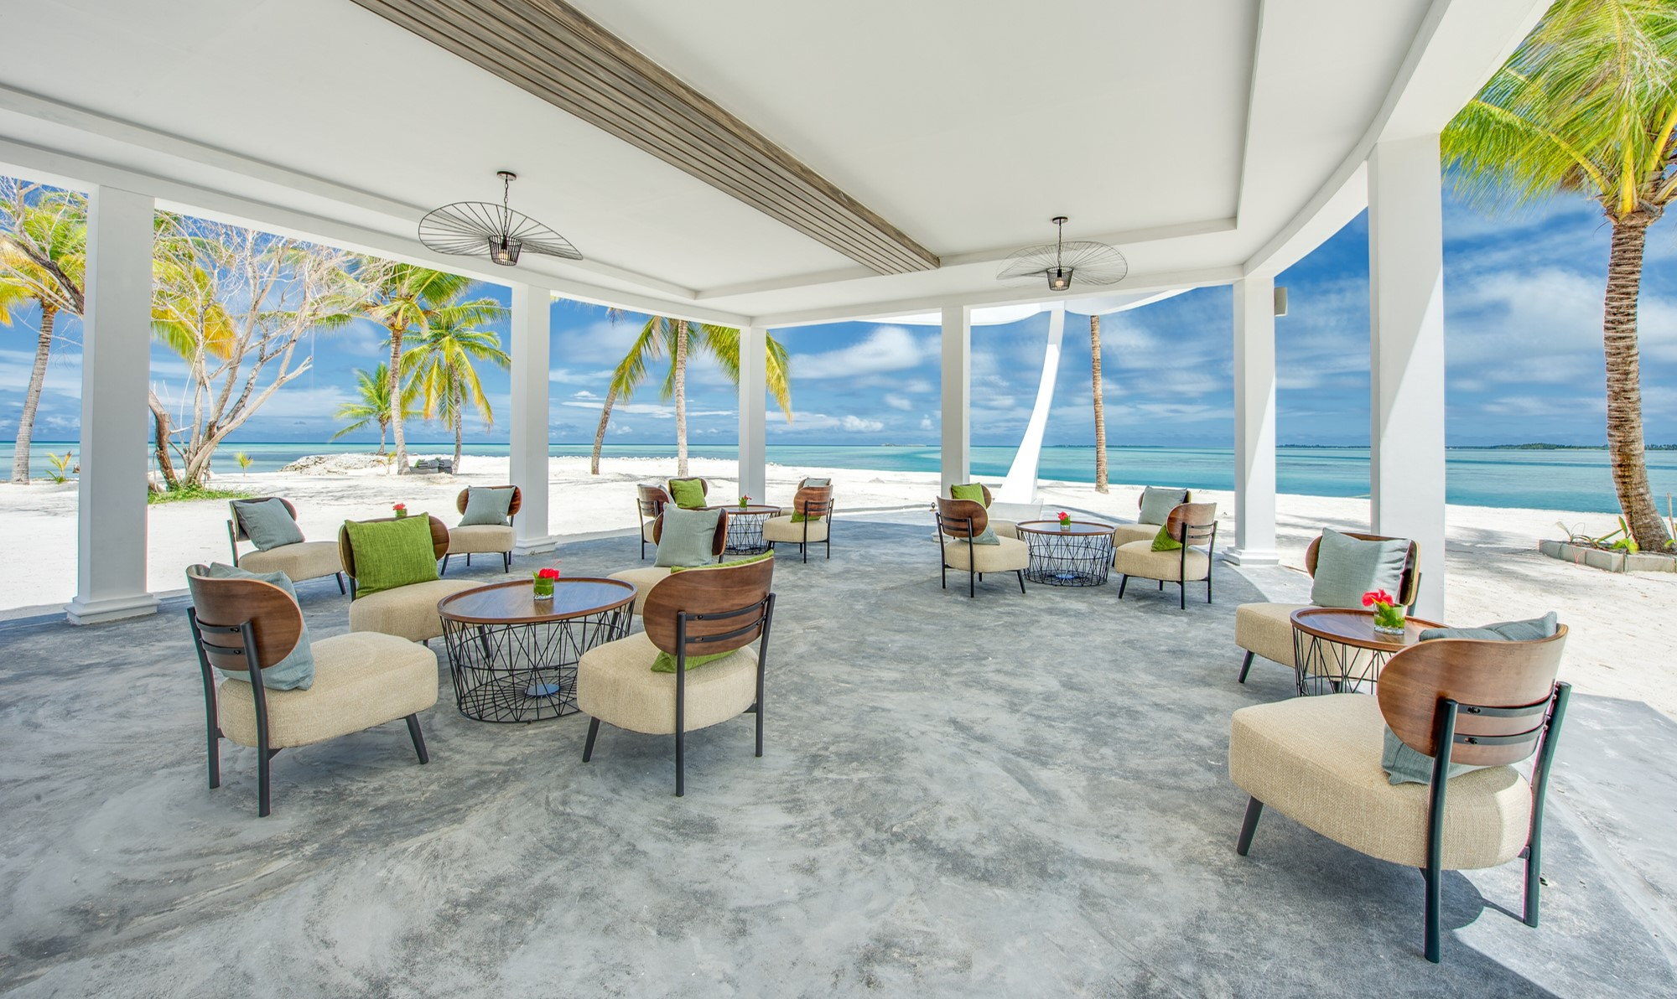
DHIRUN’BAR
Kick back and chill to lounge music during the day, with your favorite snack and drink

Slide 32
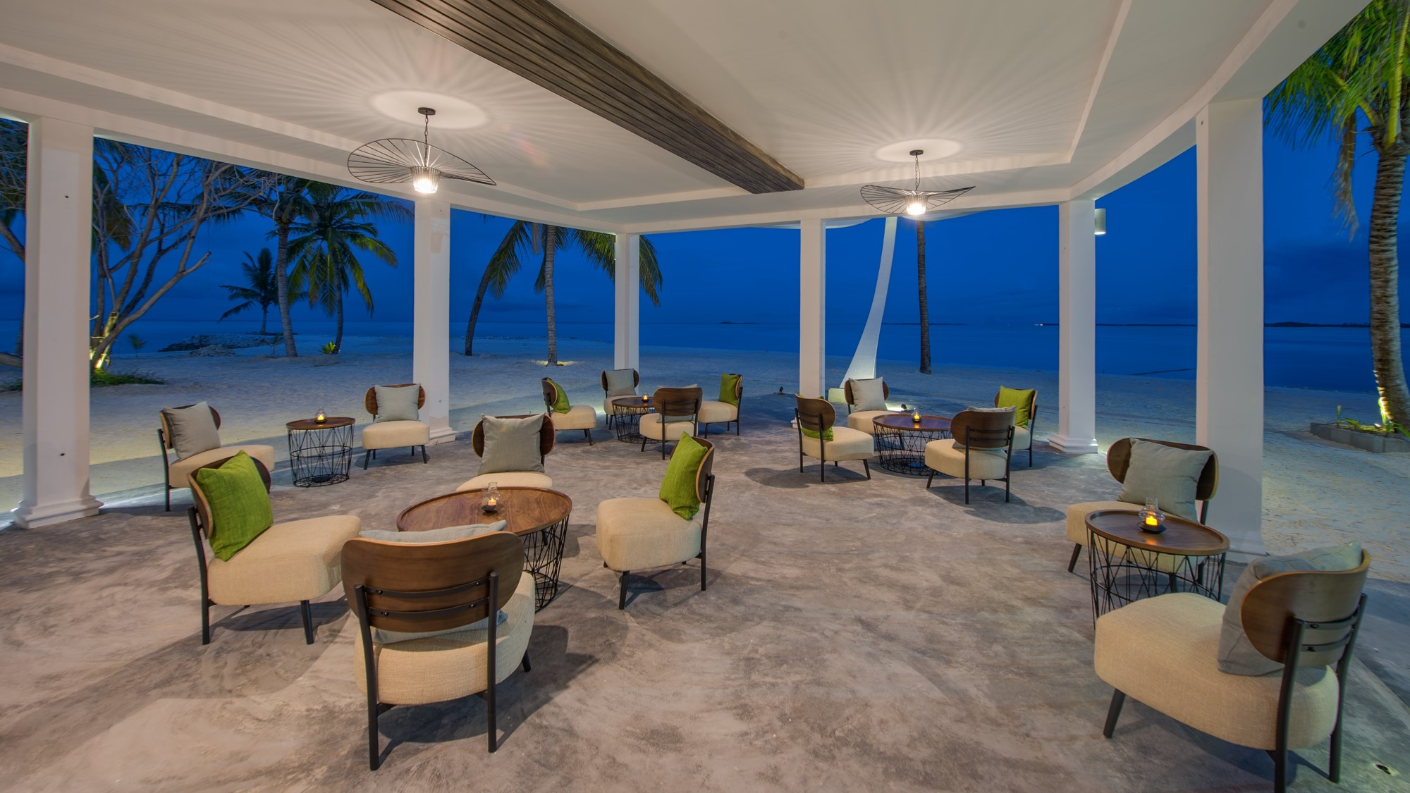
DHIRUN’BAR
Enjoy a fine selection of beverages from around the world in the most relaxed setting…

Slide 33
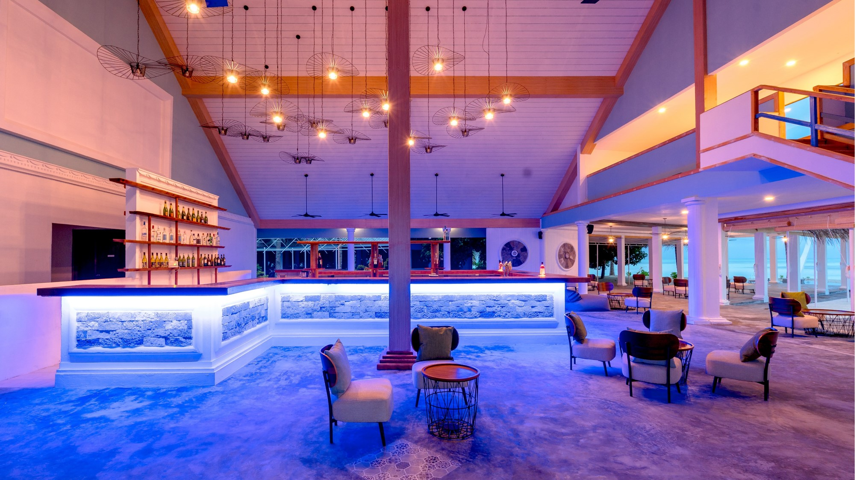
DHIRUN’BAR
… or dance away the night to the latest beats!

Slide 34
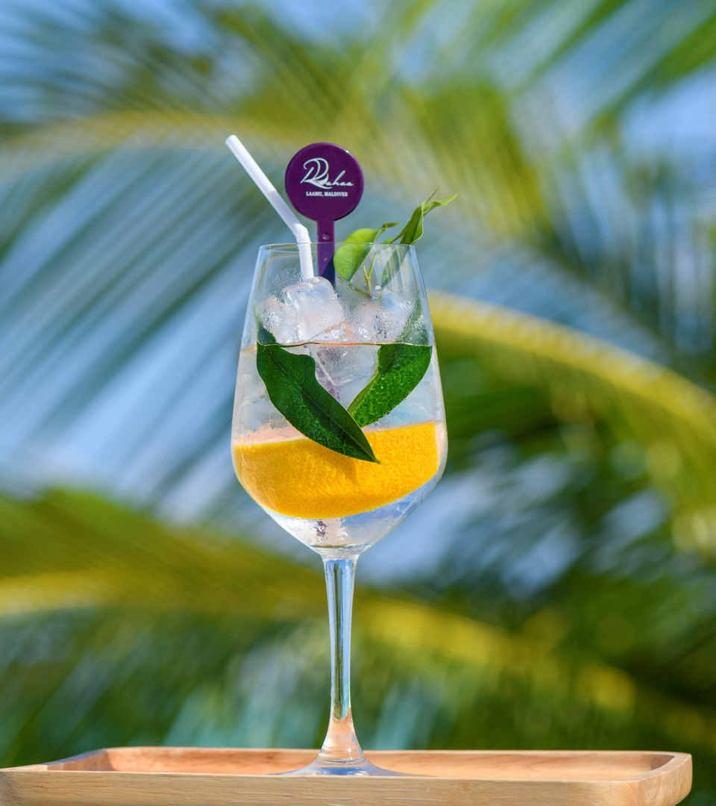
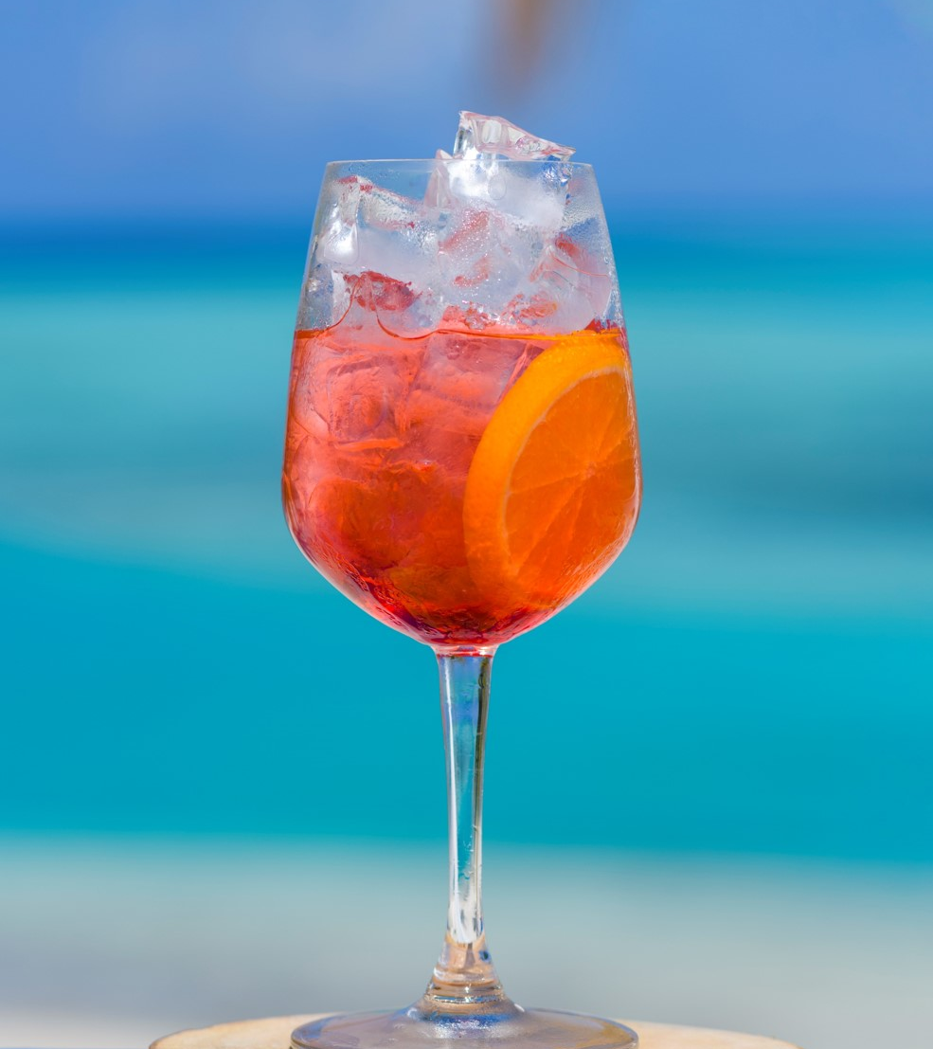
DHIRUN’BAR
Refreshing Cocktails & mocktails

Slide 35
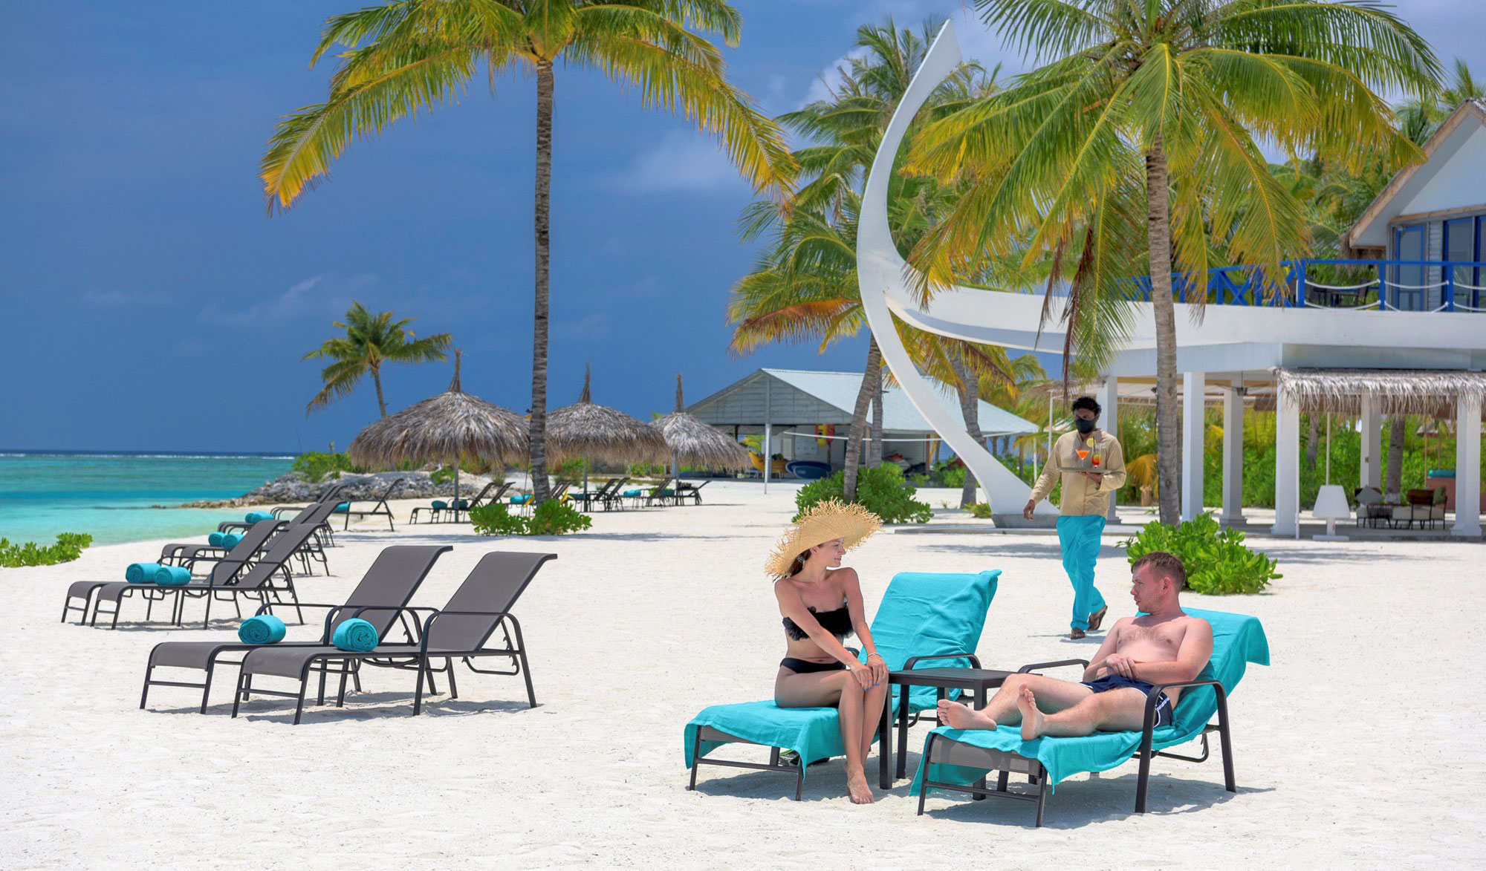

Slide 36
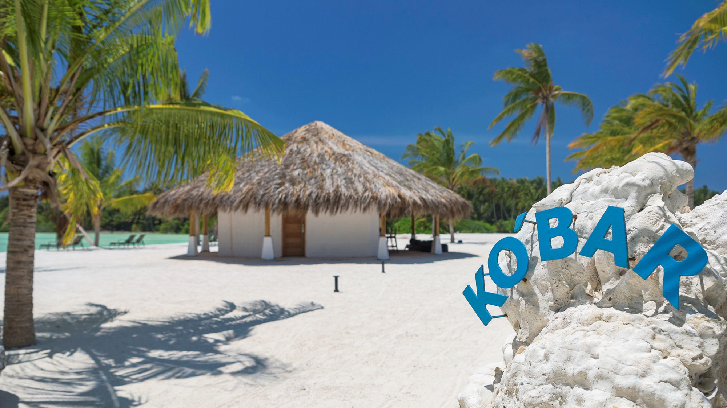
KO’BAR
SUNSET BEACH BAR

Slide 37
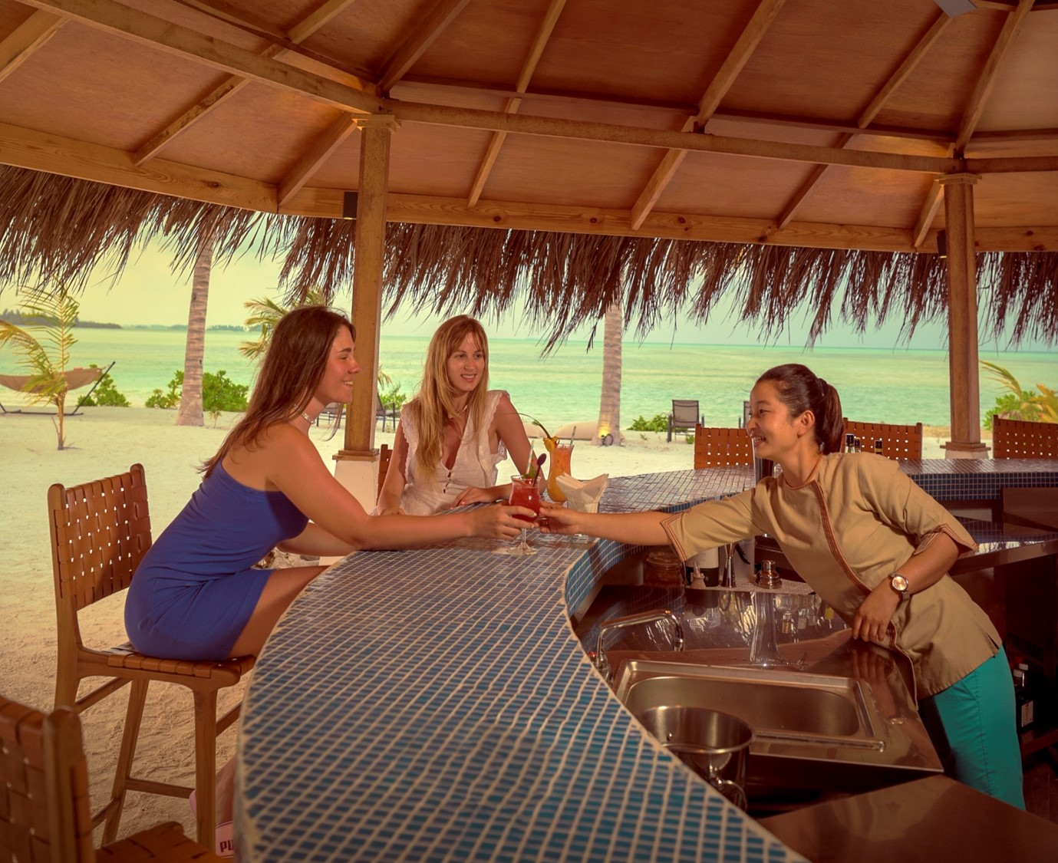
KO’BAR
SUNSET BEACH BAR
“
Grab a cold drink and our signature Pizza after a swim, chill in a hammock with a book and a king coconut, or even better, enjoy the magnificent sunset views with a cocktail in hand!
”

Slide 38
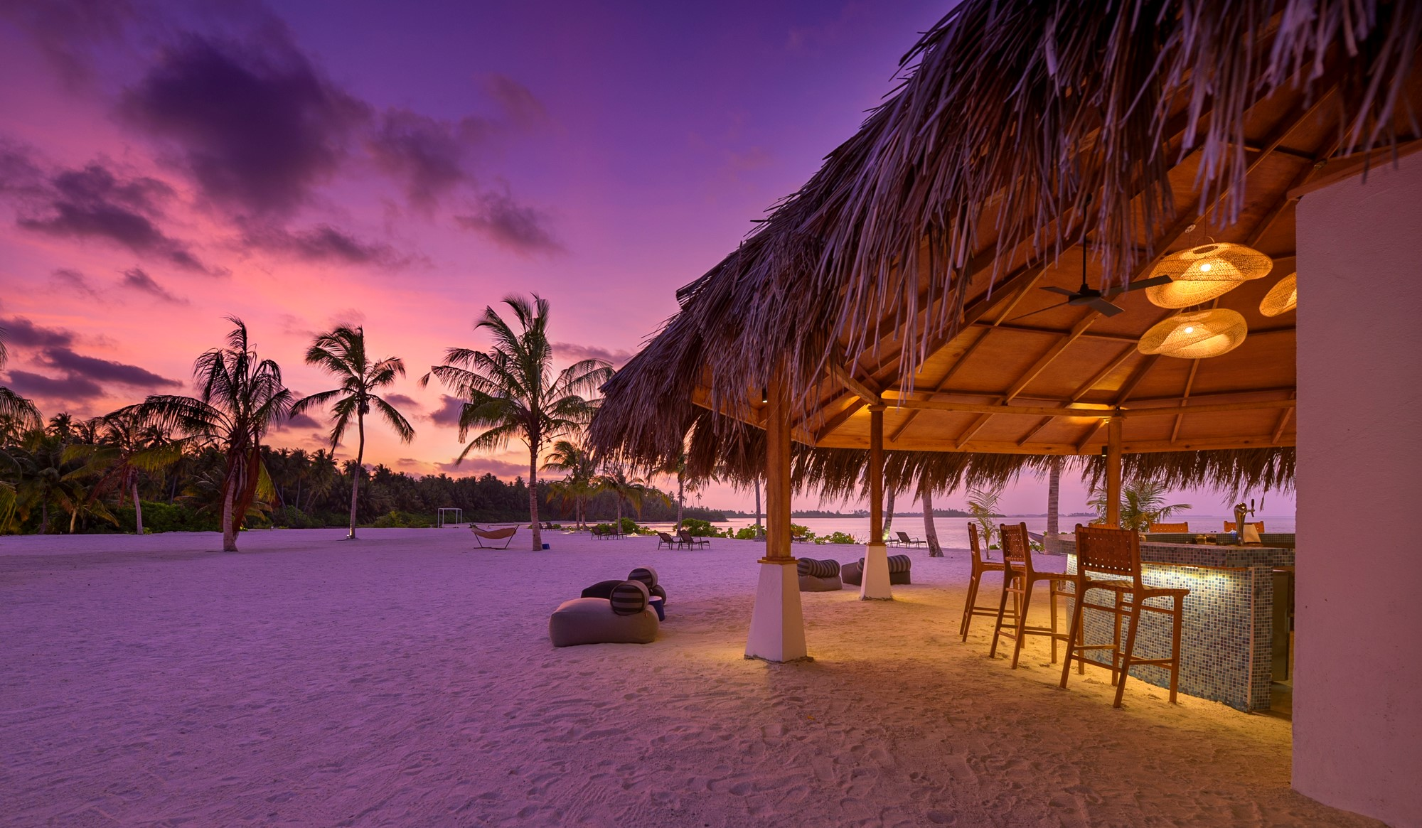
KO’BAR
SUNSET BEACH BAR
The ocean on one side, the lake on the other, the sunset right in front and cool music playing throughout the day, KO’BAR is the ultimate place to be for sunset.

Slide 39
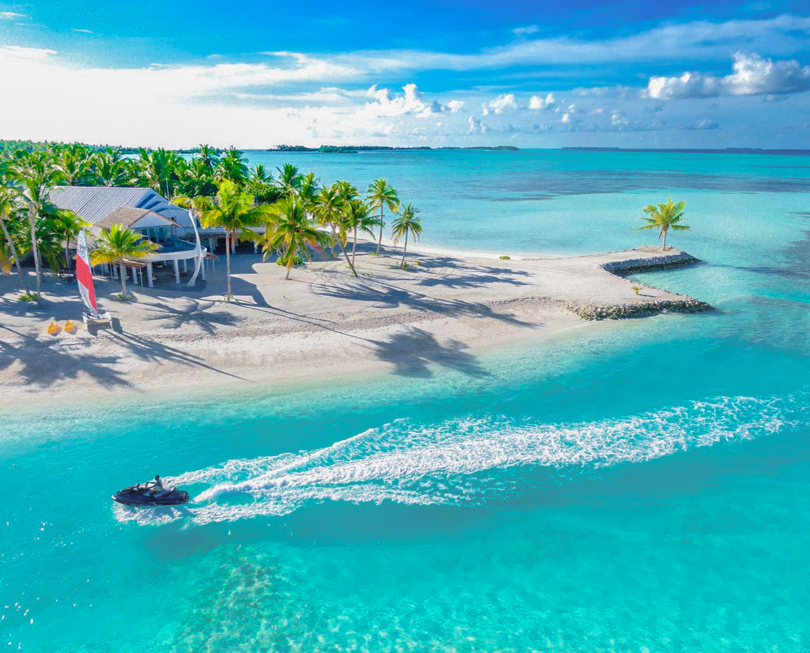
RECREATION & EXPLORATION
.
Diving
Water sports
Surfing
Spa
Destination Dining
Picnics
Weddings & Renewal of Vows
Excursions including: Handline fishing, dolphin cruise, local island adventure, snorkelling trips, desert island picnics and big game fishing

Slide 40
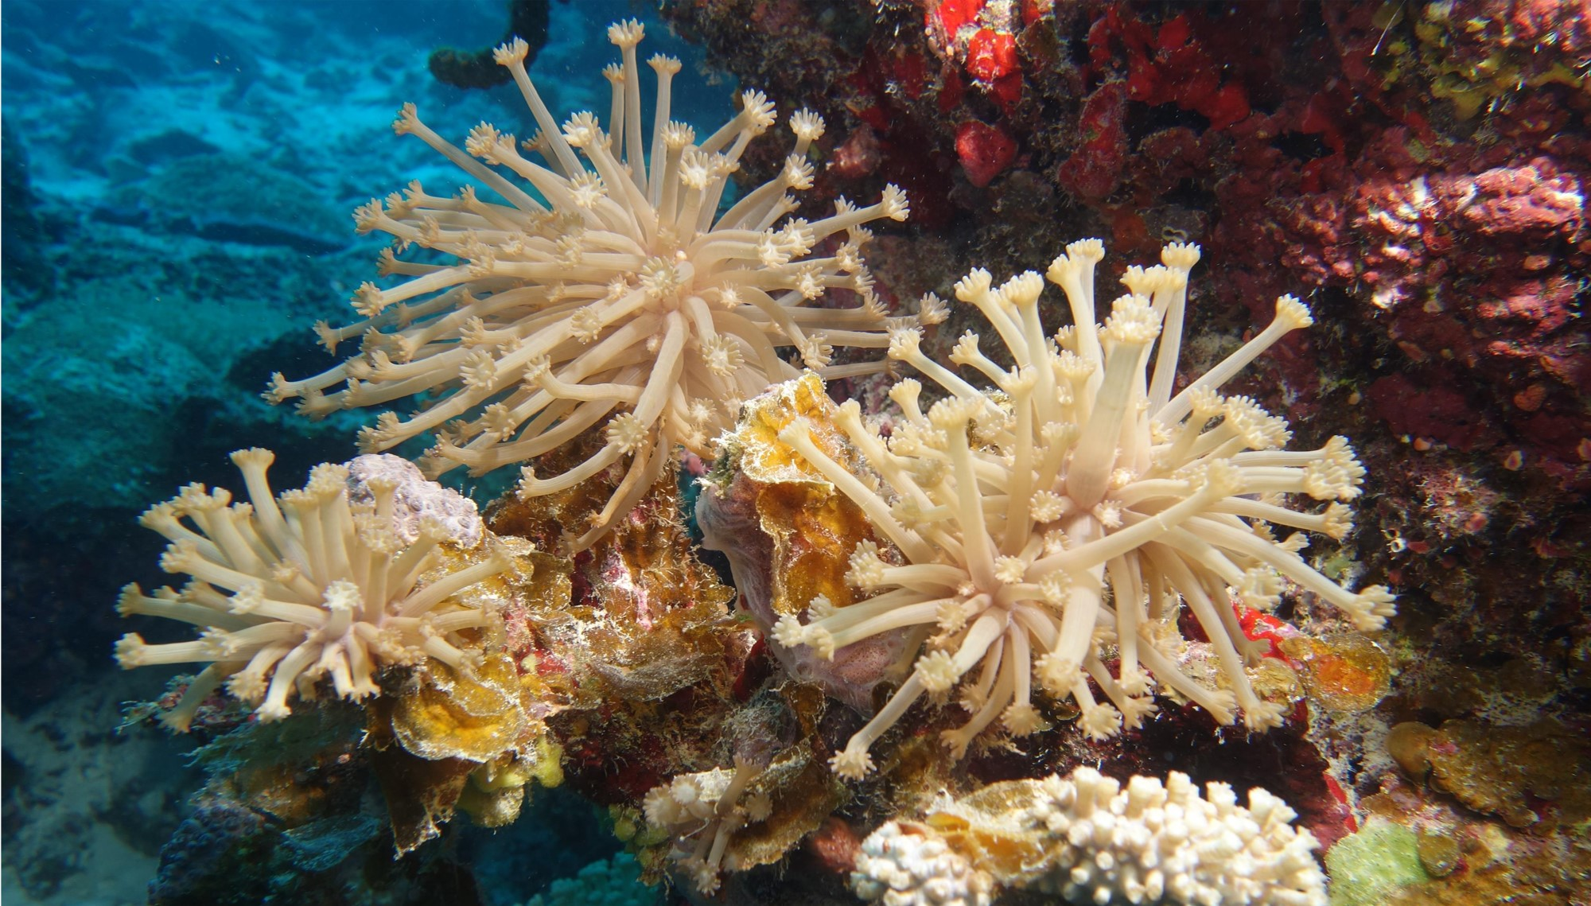
SNORKELING & DIVING
Experience the incredible underwater world of the vibrant Laamu Atoll with our instructors during a dive or a snorkeling trip

Slide 41
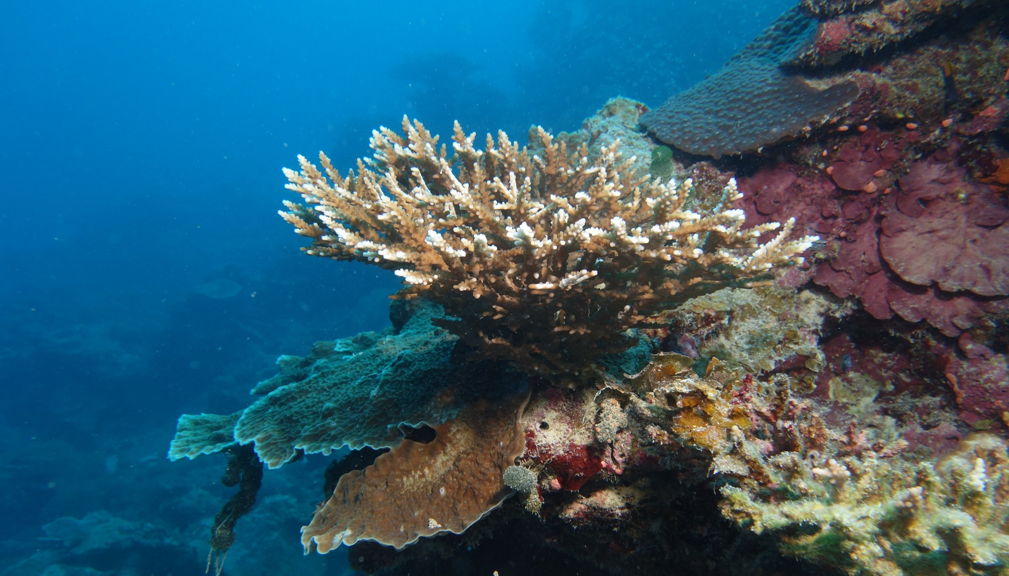
DIVING
A selection of Scuba Diving
Courses are available including Bubble maker, beginner to refresher courses

Slide 42
Eco Water Sports
(non-motorized)
Catamaran Sailing
Windsurfing
Kayaks and SUP (Stand up Paddle)
Kite surfing
WATER SPORTS
WATER SPORTS
Power Water Sports
(Motorized)
Jet Ski
Power boating
Water Skiing, Wake & Knee boarding
Fly boarding
Tube & Banana rides

Slide 43
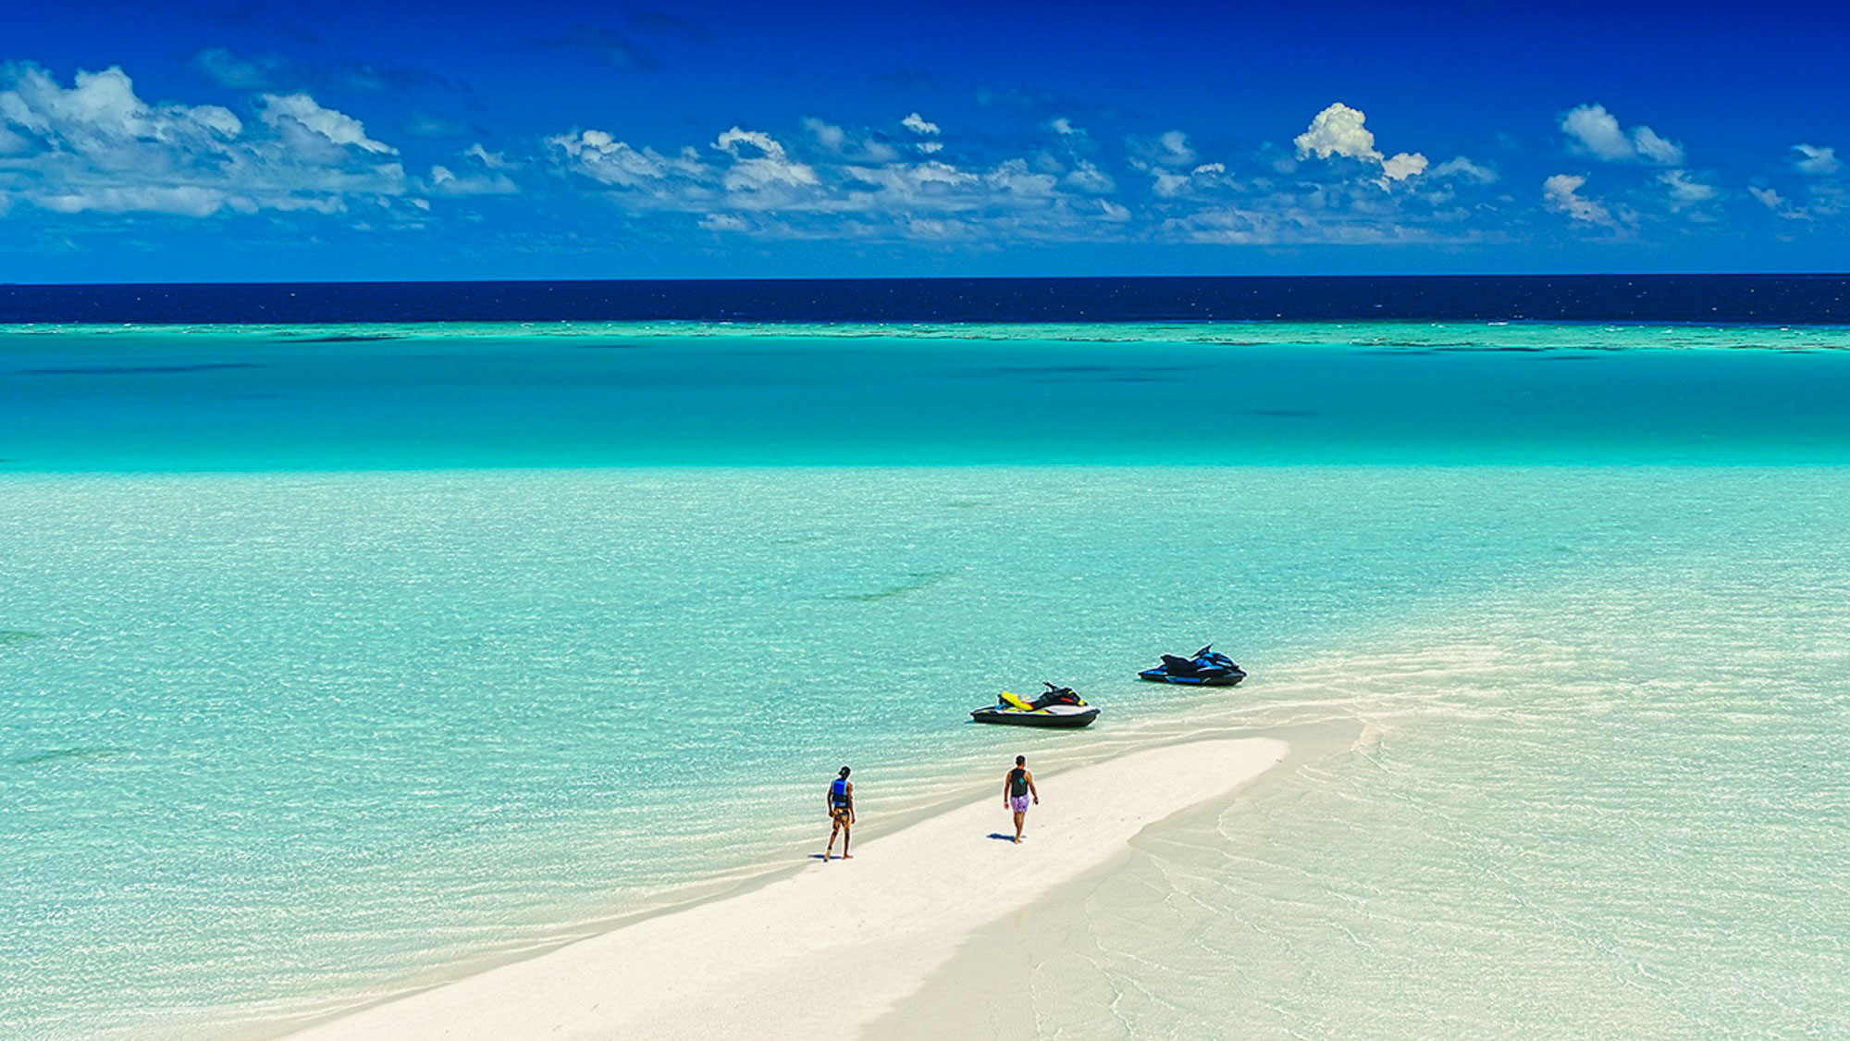
WATER SPORTS
Explore the nearby virgin islands and sandbanks on a Jet Ski

Slide 44
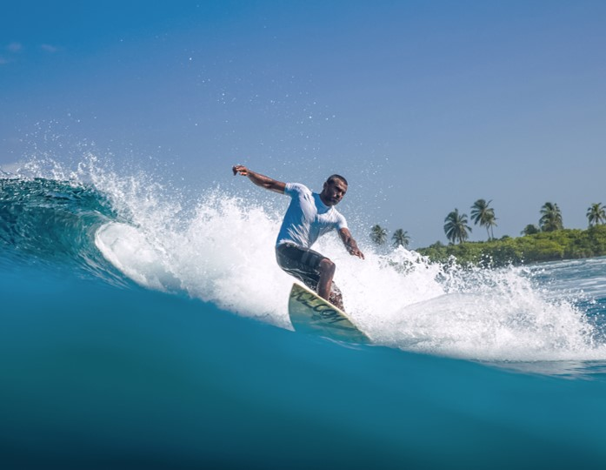
SURFING
“
With the right combination of the season and weather, you may be one of the luckiest to surf in the Maldives
Maldivian waters are crystal-clear, and the waves are great for beginners to pro surfers
”
SURFING
Near by surf points
Three great surf points within close distance of Rahaa
Yin Yang
Petrols
Machines
Ying Yangs
Petrols
Machines

Slide 45
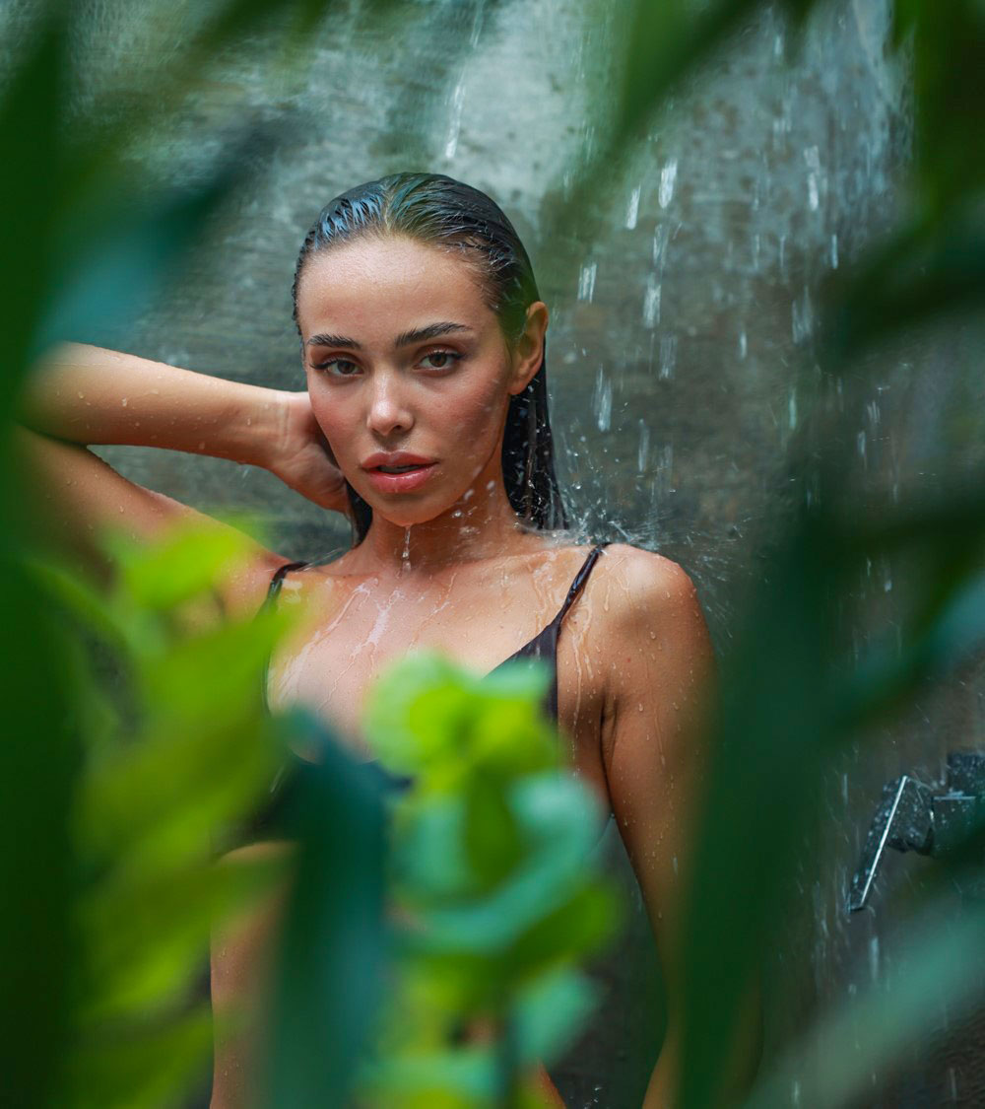
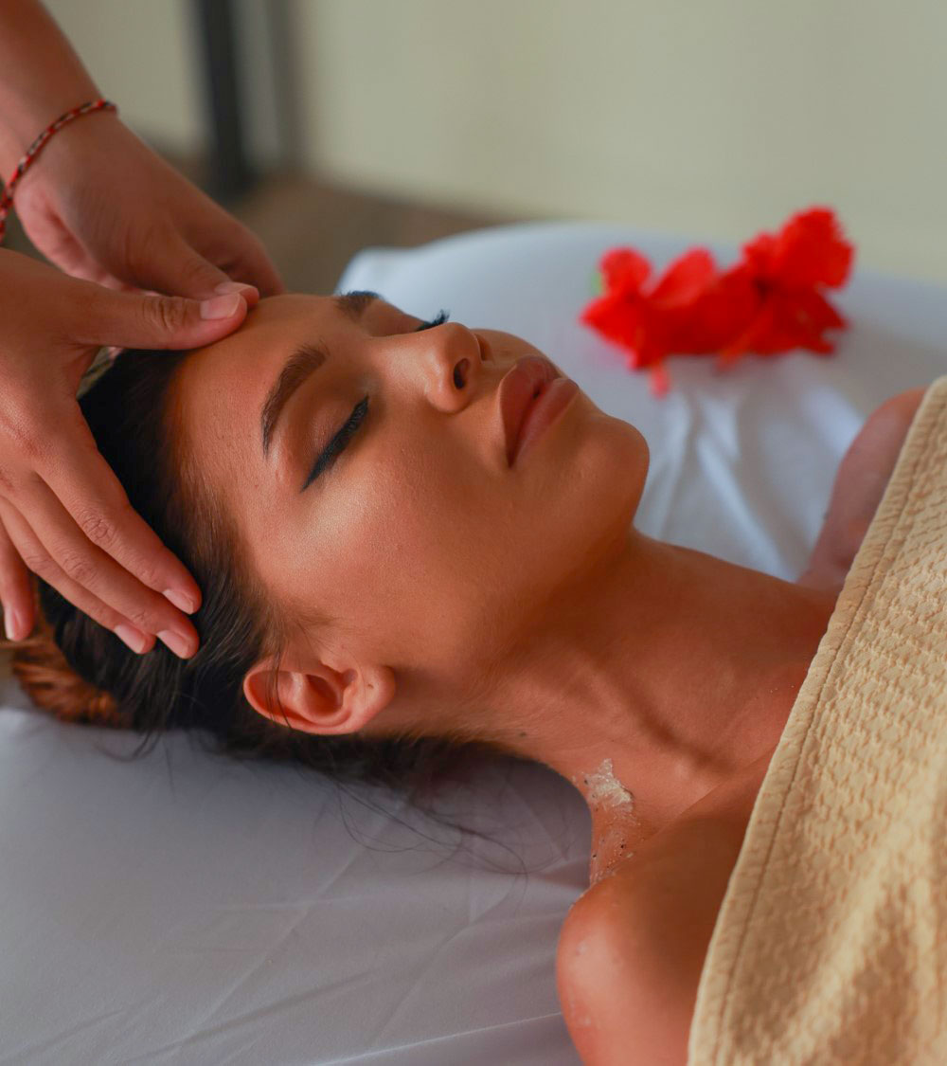
RAHAA SPA

Slide 46
RAHAA SPA
Well-trained professional Spa therapists
Couples and Single private treatment suites
Personalized experience of ultimate relaxation
Exotic, relaxing, & therapeutic menu of treatments

Slide 47
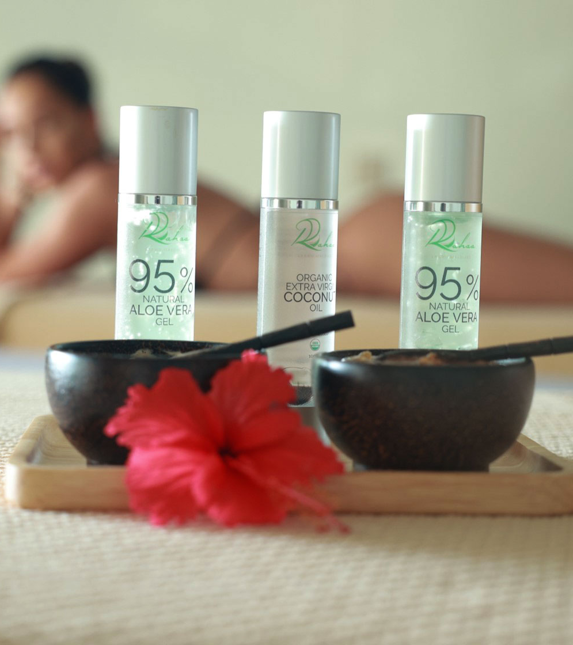
RAHAA SPA

Slide 48
PICNICS
“
Picnics on the beach or on a deserted island or even on a sandbank
”

Slide 49
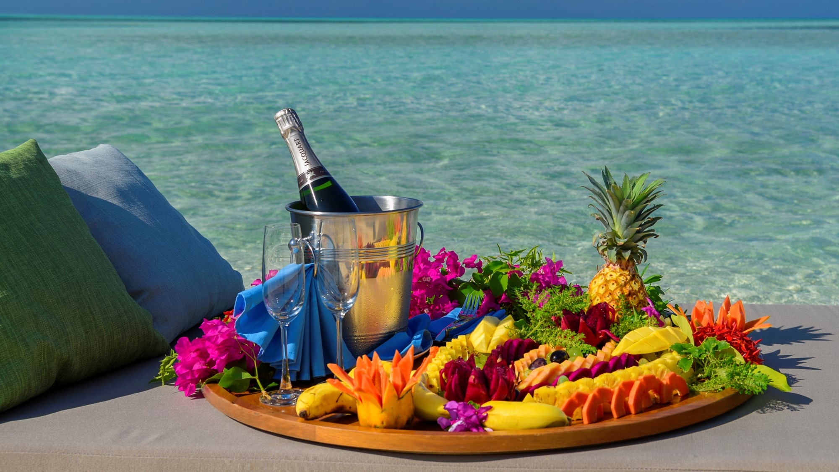

Slide 50
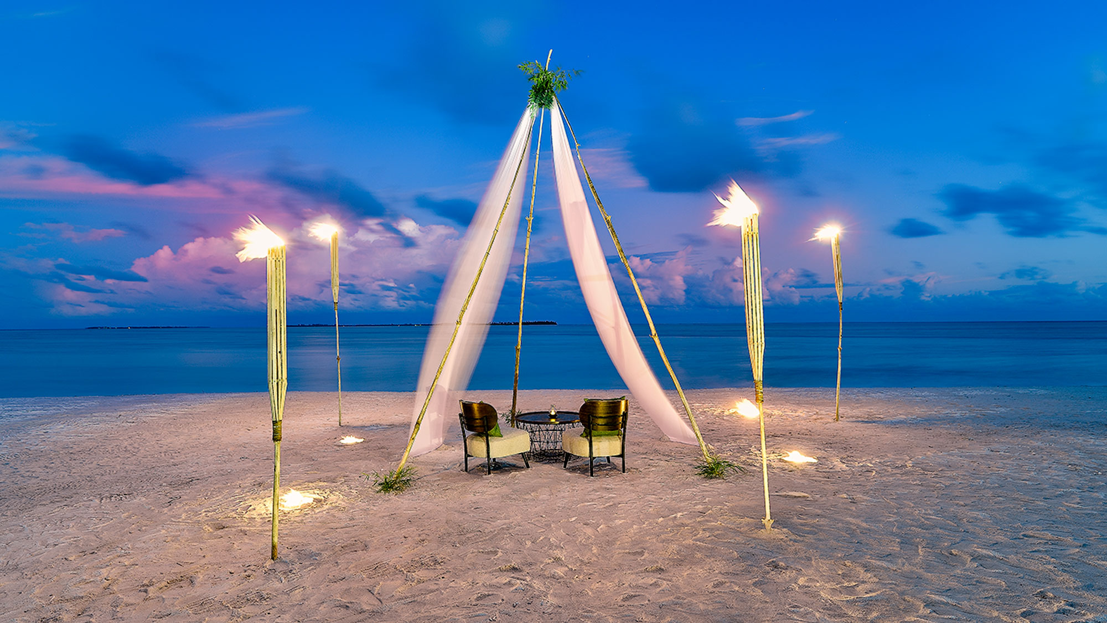
WEDDINGS AND RENEWAL OF VOWS
Make your dream “I do” moment come true at Rahaa the way you have always imagined. - on a tropical island, on the beach, far-far away!

Slide 51
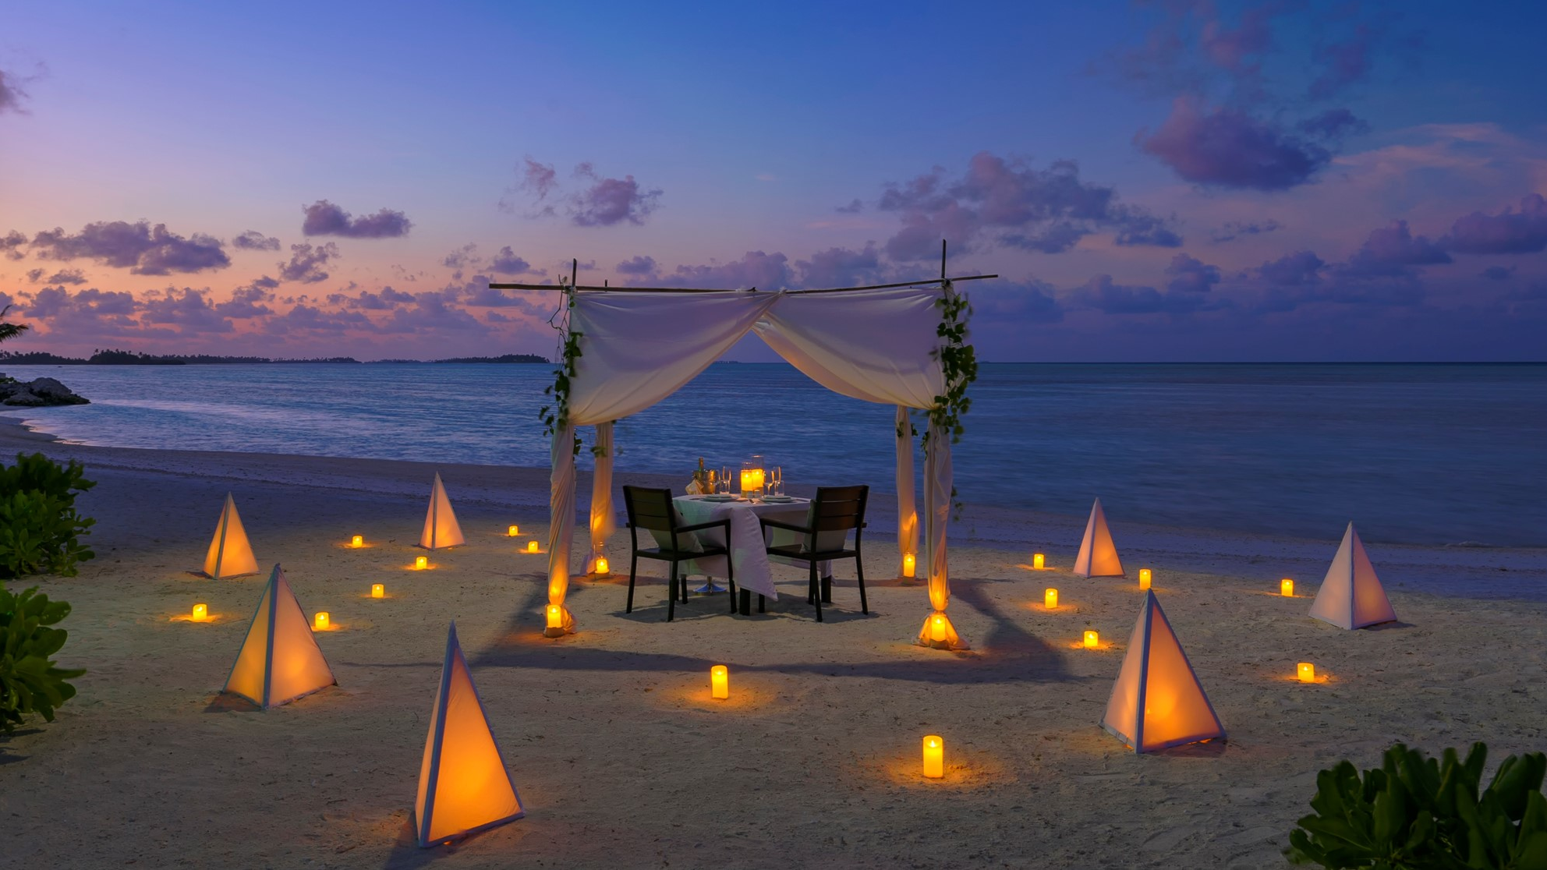

Slide 52
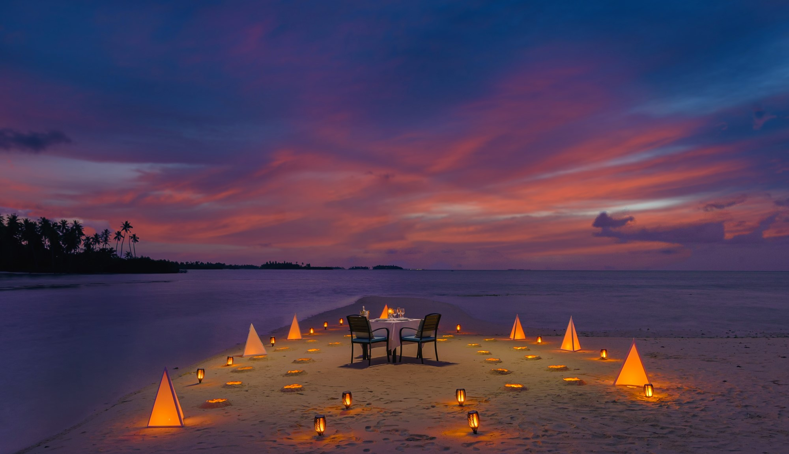
DESTINATION DINING
A unique location for a special dinner with your loved one. A romantic spot on the beach, by the lake, or on an uninhabited island.

Slide 53
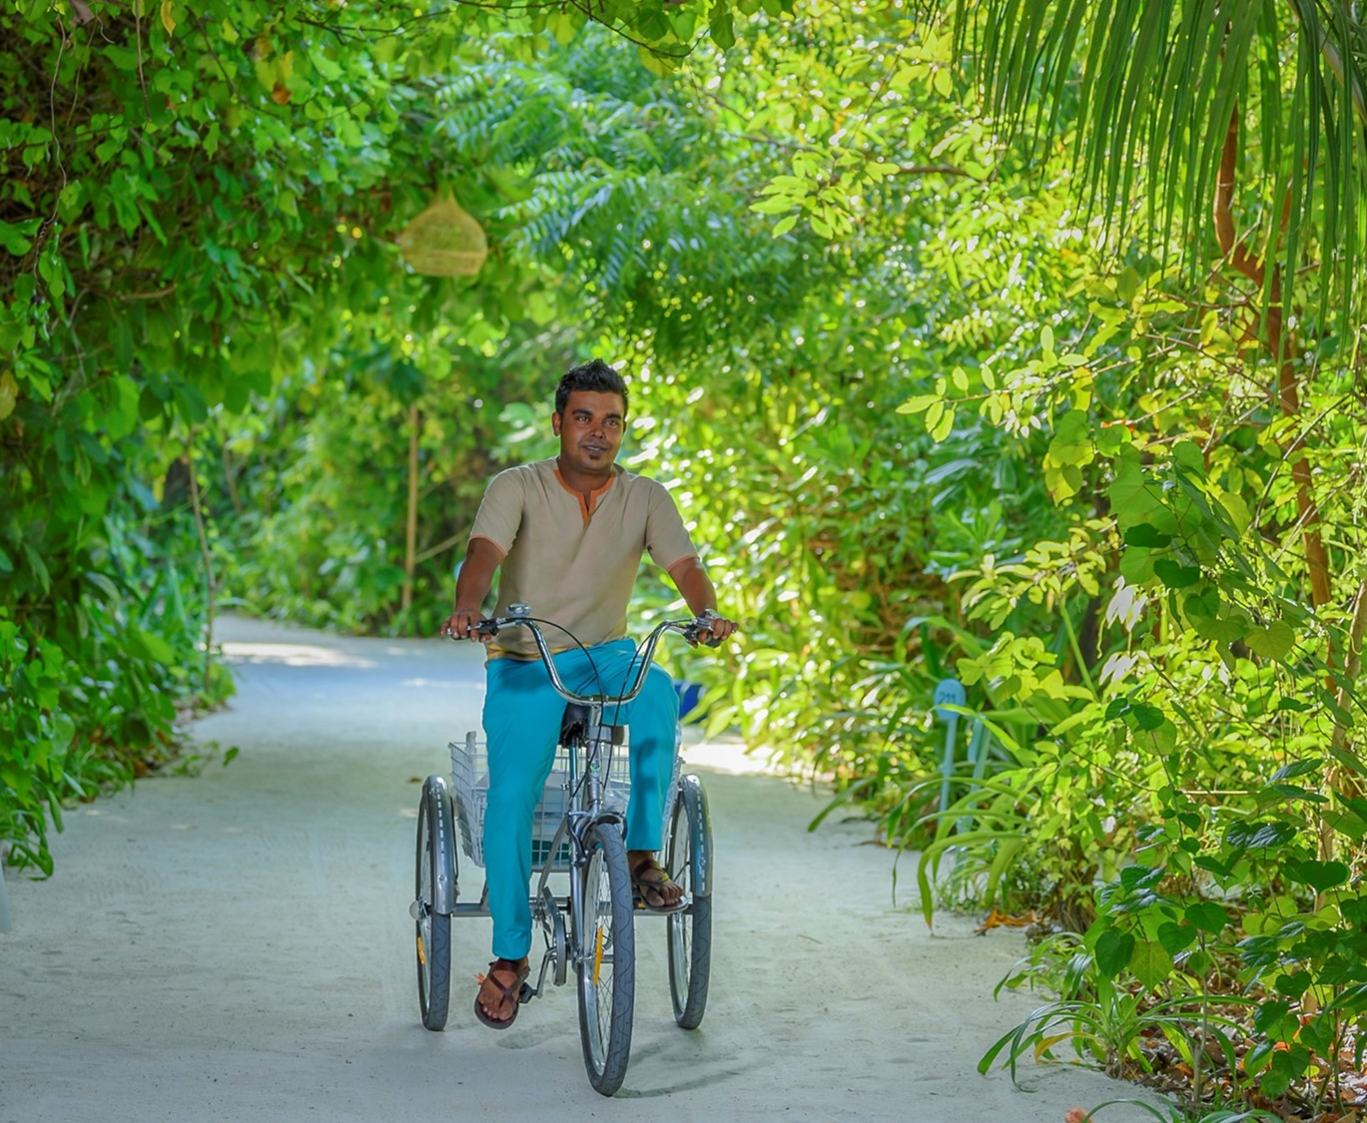
OUR SERVICES & FACILITIES
House keeping service is provided twice a day
Laundry service and pressing
In Villa dining
All Villas are serviced by our friendly local team members
Sports including badminton, beach volleyball & table tennis
Board games, cards, karaoke, live music & entertainment
Fitness Room
Boutique
Kids play area

Slide 54
www.rahaaresort.com

